Slide 1
Quantitative Risk Management Lecture 3: More Multivariate Distributions and Intro to Copulas
Roy E. DeMeo, Jr.

Slide 2
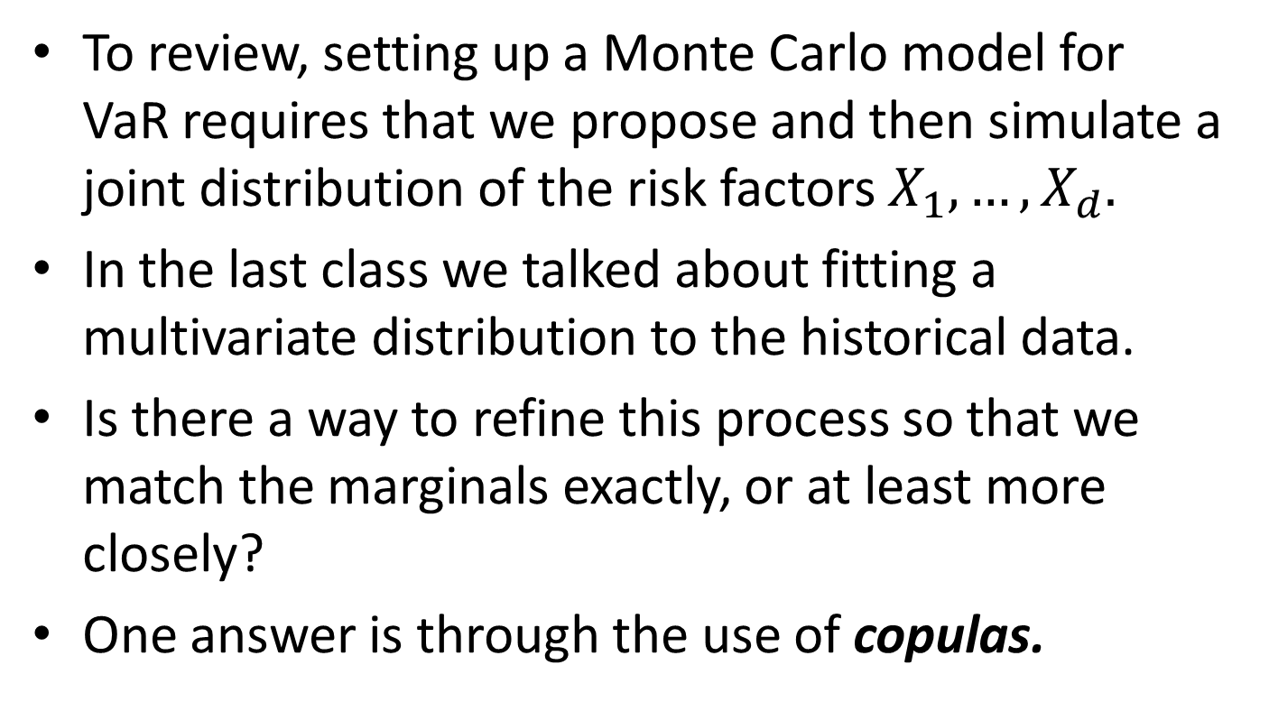
Setting up an MC VaR Model - Copulas
To review, setting up a Monte Carlo model for VaR requires that we propose and then simulate a joint distribution of the risk factors $X_{1},…,X_{d}.$
In the last class we talked about fitting a multivariate distribution to the historical data.
Is there a way to refine this process so that we match the marginals exactly, or at least more closely?
One answer is through the use of copulas.

Slide 3
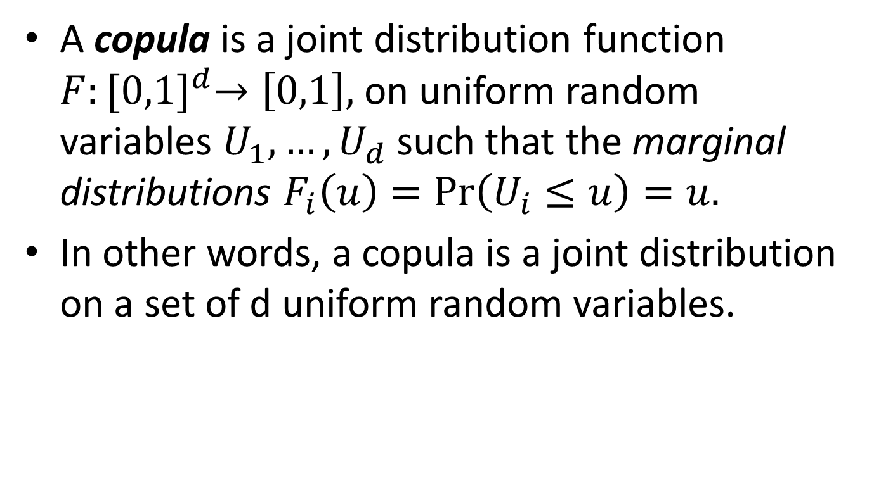
What is a Copula?
A copula is a joint distribution function $F:{[0,1]}^{d}→\left[0,1\right],$ on uniform random variables $U_{1},…,U_{d}$ such that the marginal distributions $F_{i}\left(u\right)=\operatorname{Pr}\left(U_{i}≤u\right)=u.$
In other words, a copula is a joint distribution on a set of d uniform random variables.

Slide 4
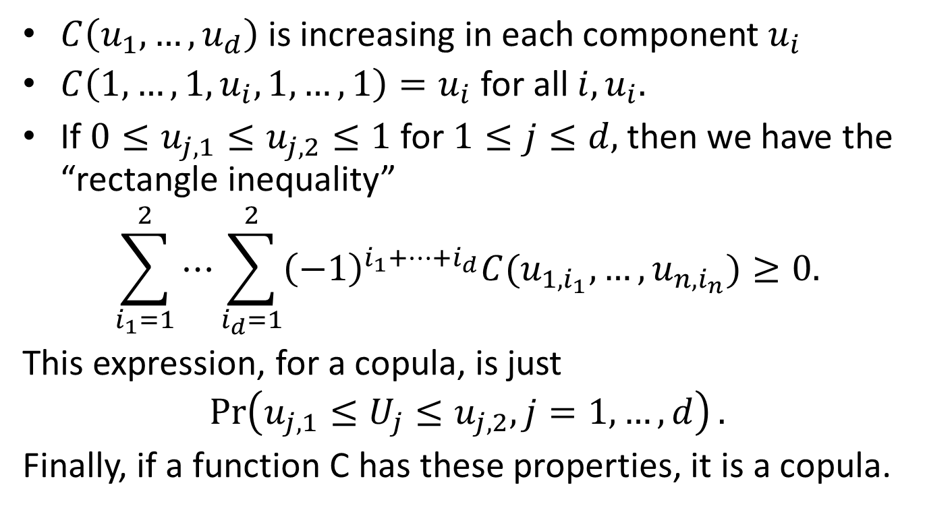
Basic Properties of Copulas
$C\left(u_{1},…,u_{d}\right)$ is increasing in each component $u_{i}$
$C\left(1,…,1,u_{i},1,…,1\right)=u_{i}$ for all $i,u_{i}.$
If $0≤u_{j,1}≤u_{j,2}≤1$ for $1≤j≤d,$ then we have the “rectangle inequality”
$$\sum_{i_{1}=1}^{2}{⋯\sum_{i_{d}=1}^{2}{{\left(−1\right)}^{i_{1}+…+i_{d}}C(u_{1,i_{1}},…,u_{n,i_{n}})}}≥0.$$
This expression, for a copula, is just
$$\operatorname{Pr}\left(u_{j,1}≤U_{j}≤u_{j,2},j=1,…,d\right).$$
Finally, if a function C has these properties, it is a copula.

Slide 5
Why are Copulas Useful?
You can use copulas to create a joint distribution from a set of univariate distributions for d risk drivers, given certain known joint information such as overall correlations.
The main theorem that allows this is known as Sklar’s Theorem.

Slide 6
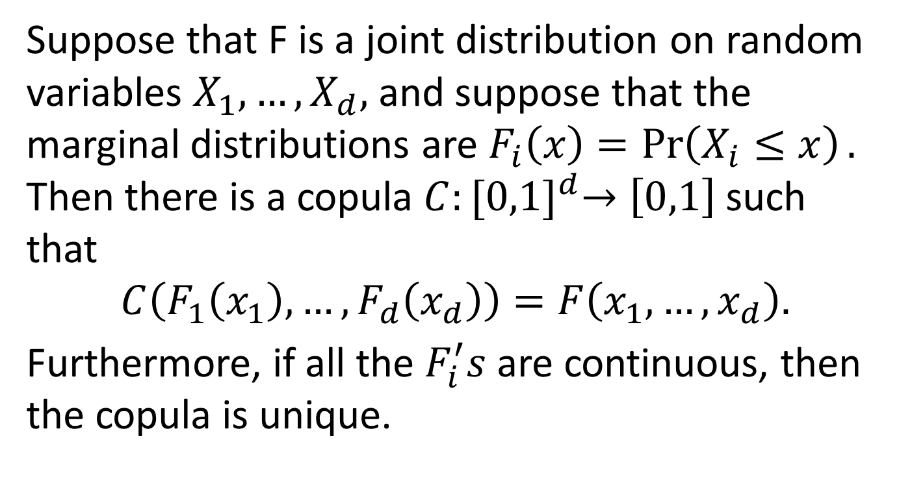
Sklar’s Theorem
Suppose that F is a joint distribution on random variables $X_{1},…,X_{d},$ and suppose that the marginal distributions are $F_{i}\left(x\right)=\operatorname{Pr}\left(X_{i}≤x\right).$ Then there is a copula $C:{[0,1]}^{d}→\left[0,1\right]$ such that
$$C\left(F_{1}\left(x_{1}\right),…,F_{d}\left(x_{d}\right)\right)=F\left(x_{1},…,x_{d}\right).$$
Furthermore, if all the $F_{i}^{′}s$ are continuous, then the copula is unique.

Slide 7

Sklar’s Theorem, Continued
Conversely If C is a copula and $F_{1},…,F_{d}$ are univariate distribution functions, then the function $F=C(F_{1}\left(x_{1}\right),…,F_{d}\left(x_{d}\right))$ is a joint distribution function with margins $F_{1},…,F_{d}$.

Slide 8
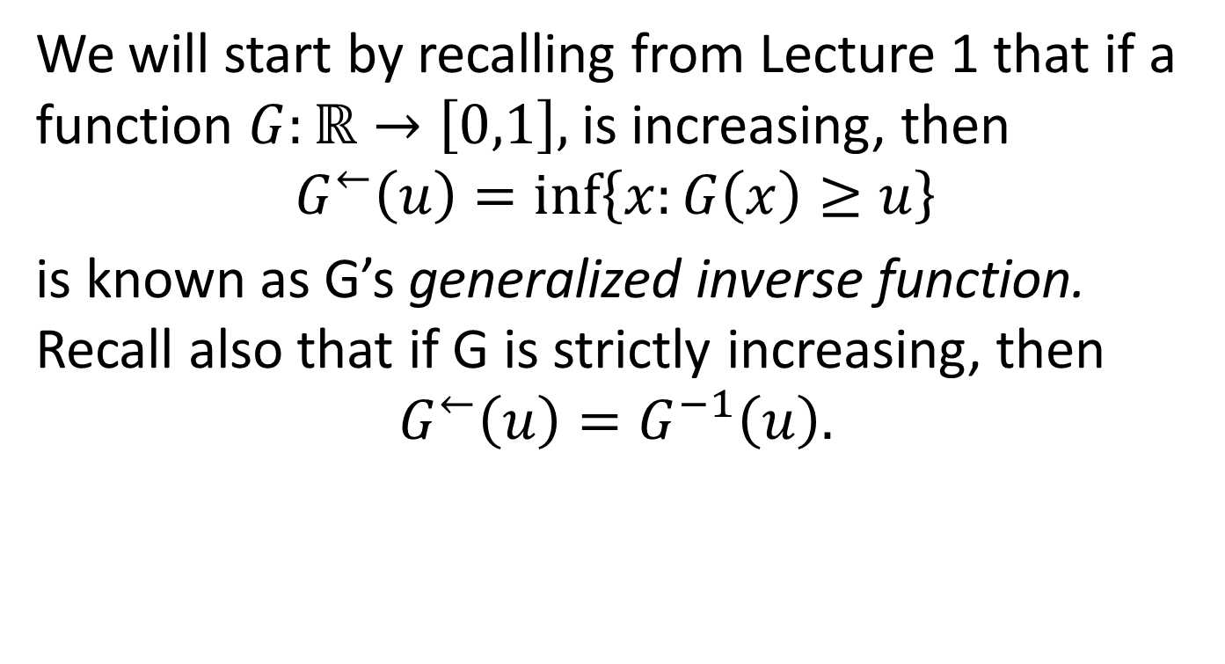
Proof in Continuous Case
We will start by recalling from Lecture 1 that if a function $G:ℝ→\left[0,1\right],$is increasing, then
$$G^{←}\left(u\right)=\inf\left\{x:G\left(x\right)≥u\right\}$$
is known as G’s generalized inverse function. Recall also that if G is strictly increasing, then
$$G^{←}\left(u\right)=G^{−1}\left(u\right).$$

Slide 9
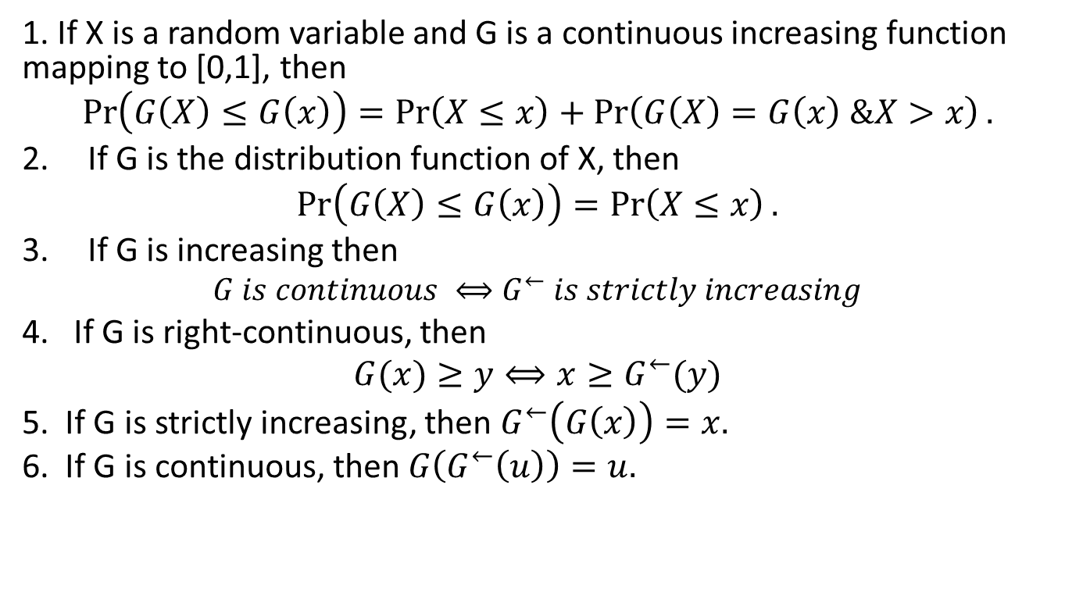
Key Facts about Continuous Increasing Functions and Generalized Inverses
1. If X is a random variable and G is a continuous increasing function mapping to [0,1], then
$$\operatorname{Pr}\left(G\left(X\right)≤G\left(x\right)\right)=\operatorname{Pr}\left(X≤x\right)+\operatorname{Pr}\left(G\left(X\right)=G\left(x\right) \&X>x\right).$$
If G is the distribution function of X, then
$$\operatorname{Pr}\left(G\left(X\right)≤G\left(x\right)\right)=\operatorname{Pr}\left(X≤x\right).$$
If G is increasing then
$$G is continuous ⟺G^{←} is strictly increasing$$
4. If G is right-continuous, then
$$G(x)≥y⟺{x≥G}^{←}(y)$$
5. If G is strictly increasing, then $G^{←}\left(G\left(x\right)\right)=x.$
6. If G is continuous, then $G\left(G^{←}\left(u\right)\right)=u.$

Slide 10
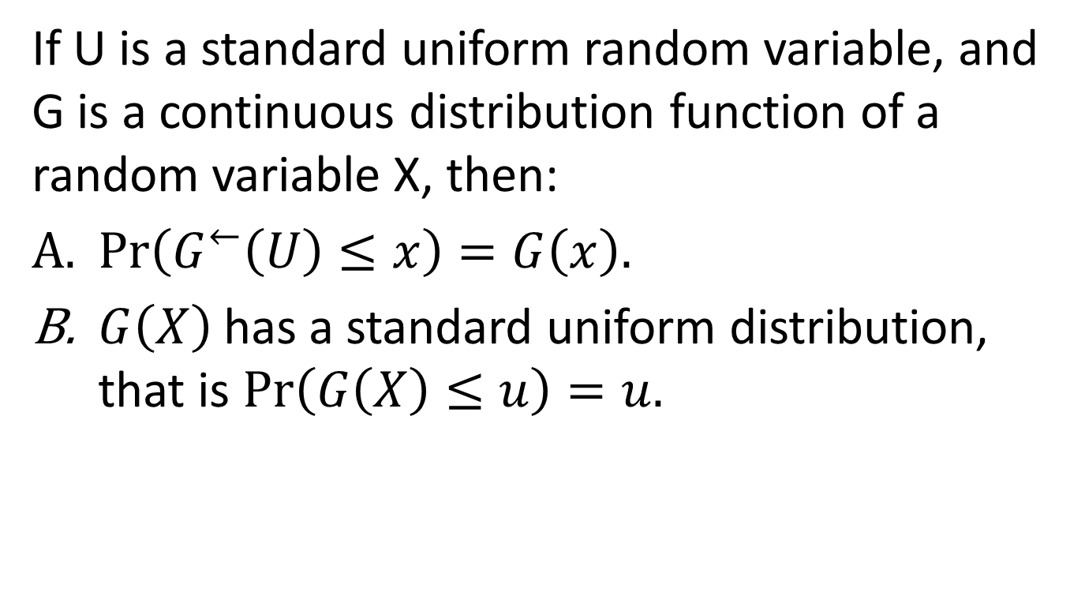
An Important Lemma
If U is a standard uniform random variable, and G is a continuous distribution function of a random variable X, then:
$Pr\left(G^{←}\left(U\right)≤x\right)=G\left(x\right).$
$G\left(X\right)$has a standard uniform distribution, that is $\operatorname{Pr}\left(G\left(X\right)≤u\right)=u.$

Slide 11
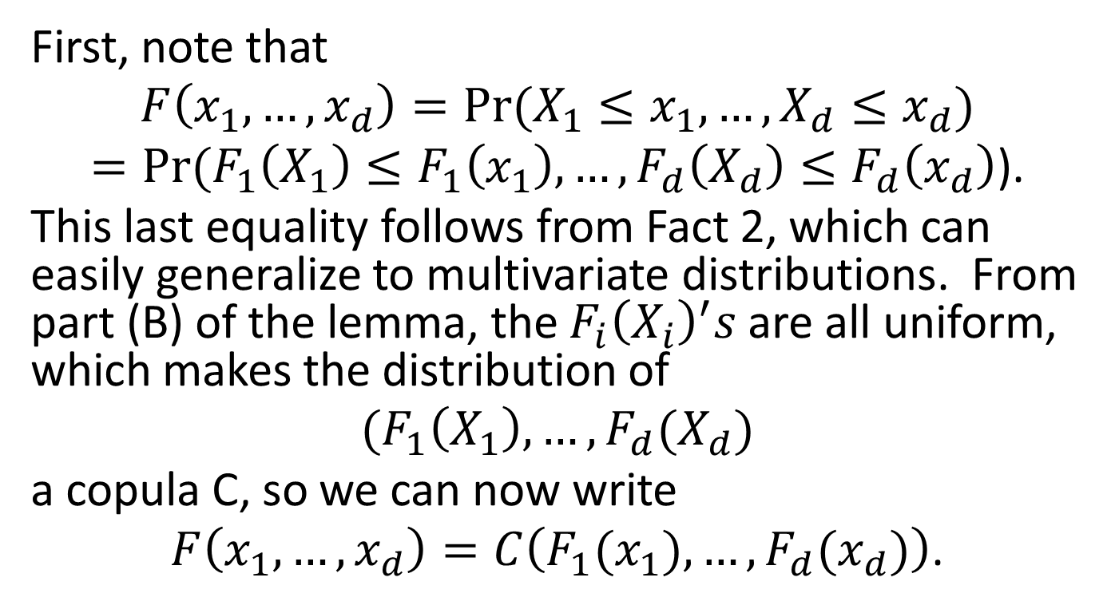
Now, the Actual Proof
First, note that
$$F\left(x_{1},…,x_{d}\right)=Pr⁡(X_{1}≤x_{1},…,X_{d}≤x_{d})$$
$=Pr⁡(F_{1}\left(X_{1}\right)≤F_{1}\left(x_{1}\right),…,F_{d}\left(X_{d}\right)≤F_{d}\left(x_{d}\right)$).
This last equality follows from Fact 2, which can easily generalize to multivariate distributions. From part (B) of the lemma, the $F_{i}{\left(X_{i}\right)}^{′}s$ are all uniform, which makes the distribution of
$$(F_{1}\left(X_{1}\right),…,F_{d}(X_{d})$$
a copula C, so we can now write
$F\left(x_{1},…,x_{d}\right)=C\left(F_{1}(x_{1}),…,F_{d}(x_{d})\right)$.

Slide 12
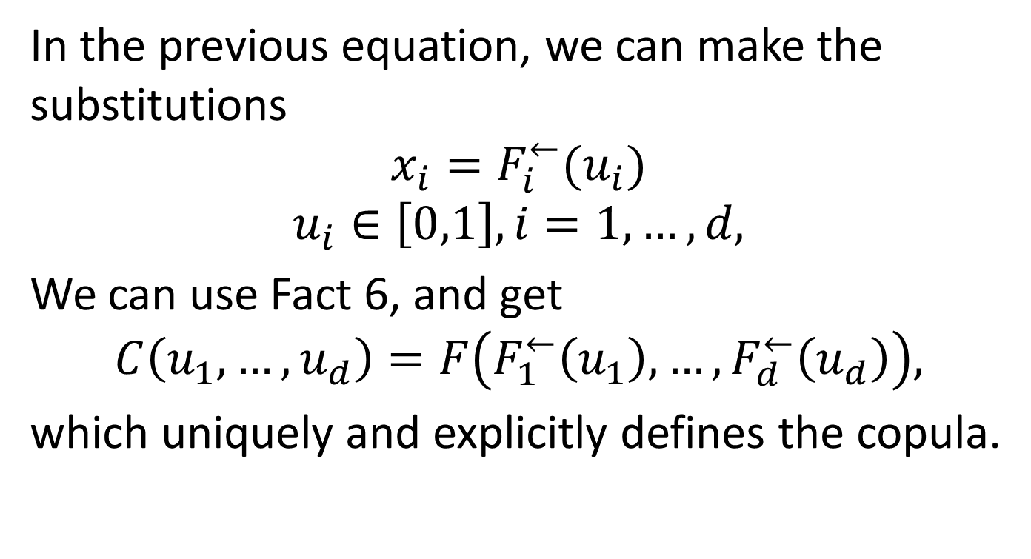
The Actual Proof, Continued
In the previous equation, we can make the substitutions
$$x_{i}=F_{i}^{←}(u_{i})$$
$$u_{i}∈\left[0,1\right], i=1,…,d,$$
We can use Fact 6, and get
$$C\left(u_{1},…,u_{d}\right)=F\left(F_{1}^{←}\left(u_{1}\right),…,F_{d}^{←}\left(u_{d}\right)\right),$$
which uniquely and explicitly defines the copula.

Slide 13
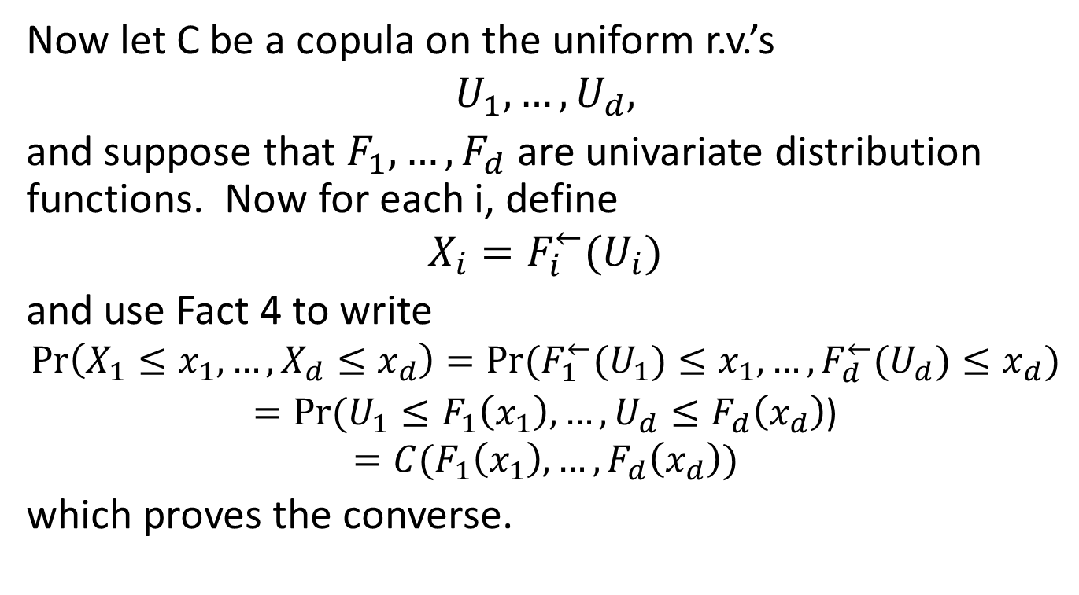
The Converse
Now let C be a copula on the uniform r.v.’s
$$U_{1},…,U_{d},$$
and suppose that $F_{1},…,F_{d}$ are univariate distribution functions. Now for each i, define
$$X_{i}=F_{i}^{←}(U_{i})$$
and use Fact 4 to write
$$\operatorname{Pr}\left(X_{1}≤x_{1},…,X_{d}≤x_{d}\right)=Pr⁡(F_{1}^{←}(U_{1})≤x_{1},…,F_{d}^{←}(U_{d})≤x_{d})$$
$=Pr⁡(U_{1}≤F_{1}\left(x_{1}\right),…,U_{d}≤F_{d}\left(x_{d}\right)$)
$$=C(F_{1}\left(x_{1}\right),…,F_{d}\left(x_{d}\right))$$
which proves the converse.

Slide 14
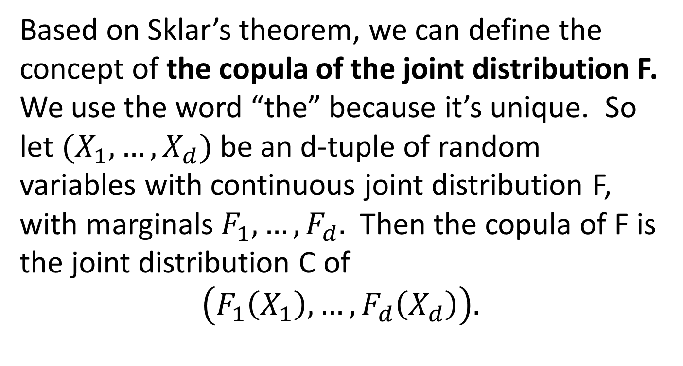
An Important Definition
Based on Sklar’s theorem, we can define the concept of the copula of the joint distribution F. We use the word “the” because it’s unique. So let $(X_{1},…,X_{d})$ be an d-tuple of random variables with continuous joint distribution F, with marginals $F_{1},…,F_{d}.$ Then the copula of F is the joint distribution C of
$$\left(F_{1}\left(X_{1}\right),…,F_{d}\left(X_{d}\right)\right).$$

Slide 15
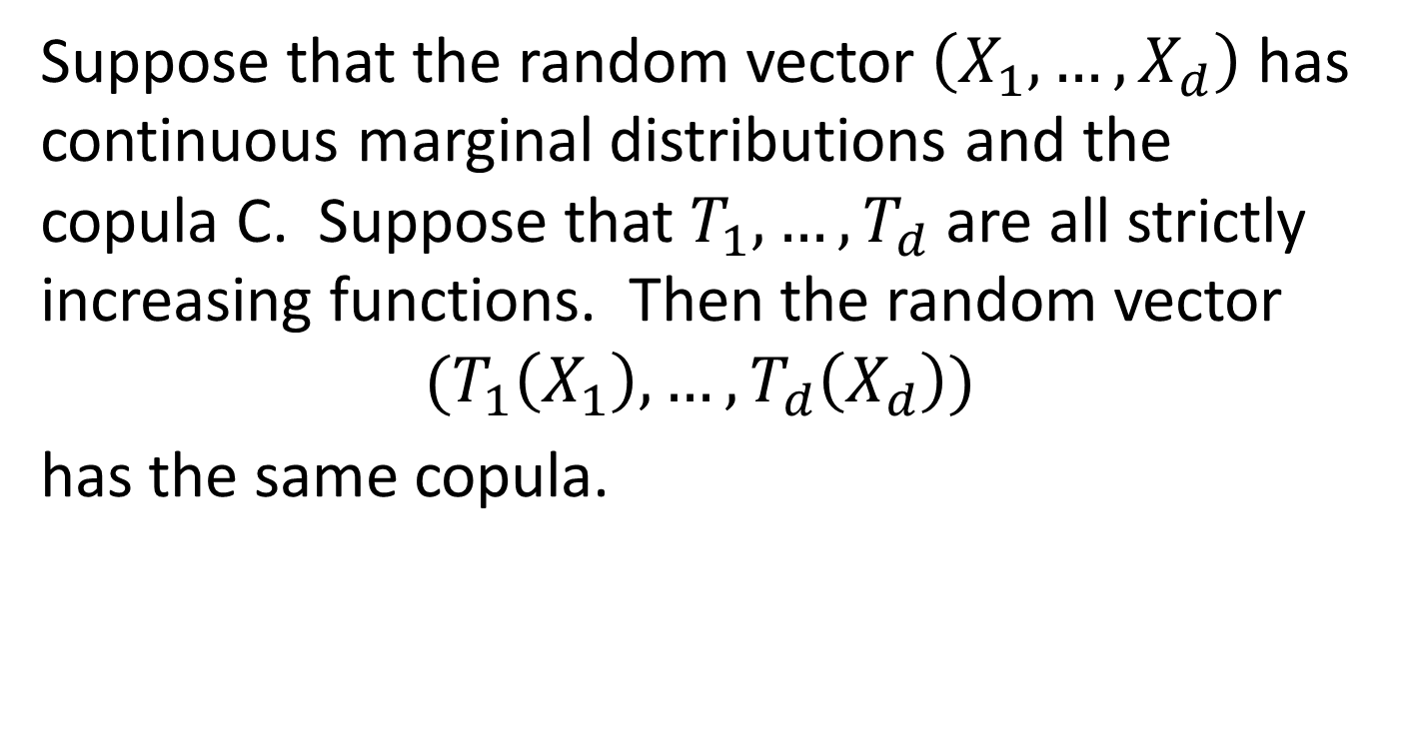
Increasing Functions of Random Variables – Same Copula
Suppose that the random vector $\left(X_{1},…,X_{d}\right)$ has continuous marginal distributions and the copula C. Suppose that $T_{1},…,T_{d}$ are all strictly increasing functions. Then the random vector
$$(T_{1}\left(X_{1}\right),…,T_{d}\left(X_{d}\right))$$
has the same copula.

Slide 16
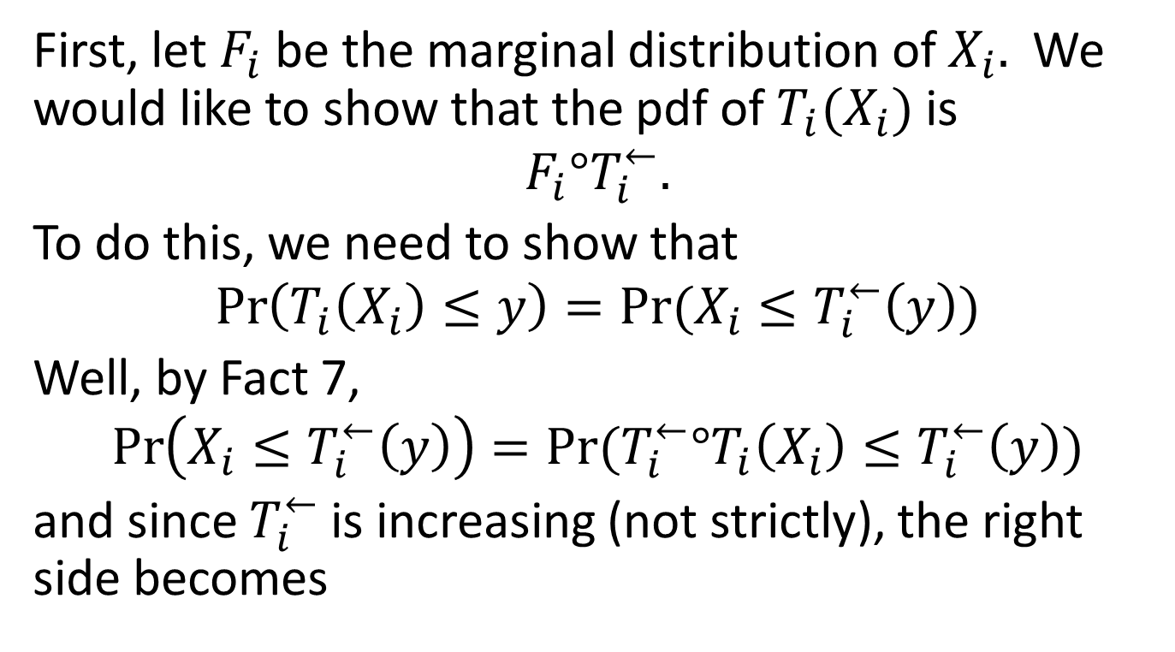
Increasing Functions, cont’d
First, let $F_{i}$ be the marginal distribution of $X_{i}.$ We would like to show that the pdf of $T_{i}(X_{i})$ is
$$F_{i}°T_{i}^{←}.$$
To do this, we need to show that
$$\operatorname{Pr}\left(T_{i}\left(X_{i}\right)≤y\right)=Pr⁡(X_{i}≤T_{i}^{←}\left(y\right))$$
Well, by Fact 7,
$$\operatorname{Pr}\left(X_{i}≤T_{i}^{←}\left(y\right)\right)=Pr⁡(T_{i}^{←}°T_{i}\left(X_{i}\right)≤T_{i}^{←}\left(y\right))$$
and since $T_{i}^{←}$ is increasing (not strictly), the right side becomes

Slide 17
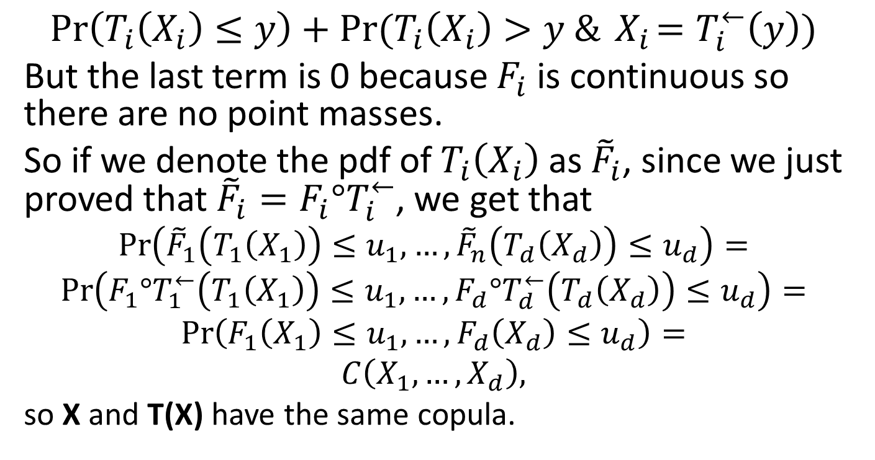
Increasing Functions, cont’d
$$\operatorname{Pr}\left(T_{i}\left(X_{i}\right)≤y\right)+Pr⁡(T_{i}\left(X_{i}\right)>y \&{ X}_{i}=T_{i}^{←}\left(y\right))$$
But the last term is 0 because $F_{i}$ is continuous so there are no point masses.
So if we denote the pdf of $T_{i}\left(X_{i}\right)$ as ${\tilde{F}}_{i}$, since we just proved that ${\tilde{F}}_{i}=F_{i}°T_{i}^{←}$, we get that
$$\operatorname{Pr}\left({\tilde{F}}_{1}\left(T_{1}\left(X_{1}\right)\right)≤u_{1},…,{\tilde{F}}_{n}\left(T_{d}\left(X_{d}\right)\right)≤u_{d}\right)=$$
$$\operatorname{Pr}\left(F_{1}°T_{1}^{←}\left(T_{1}\left(X_{1}\right)\right)≤u_{1},…,F_{d}°T_{d}^{←}\left(T_{d}\left(X_{d}\right)\right)≤u_{d}\right)=$$
$$\operatorname{Pr}\left(F_{1}\left(X_{1}\right)≤u_{1},…,F_{d}\left(X_{d}\right)≤u_{d}\right)=$$
$$C\left(X_{1},…,X_{d}\right),$$
so X and T(X) have the same copula.

Slide 18
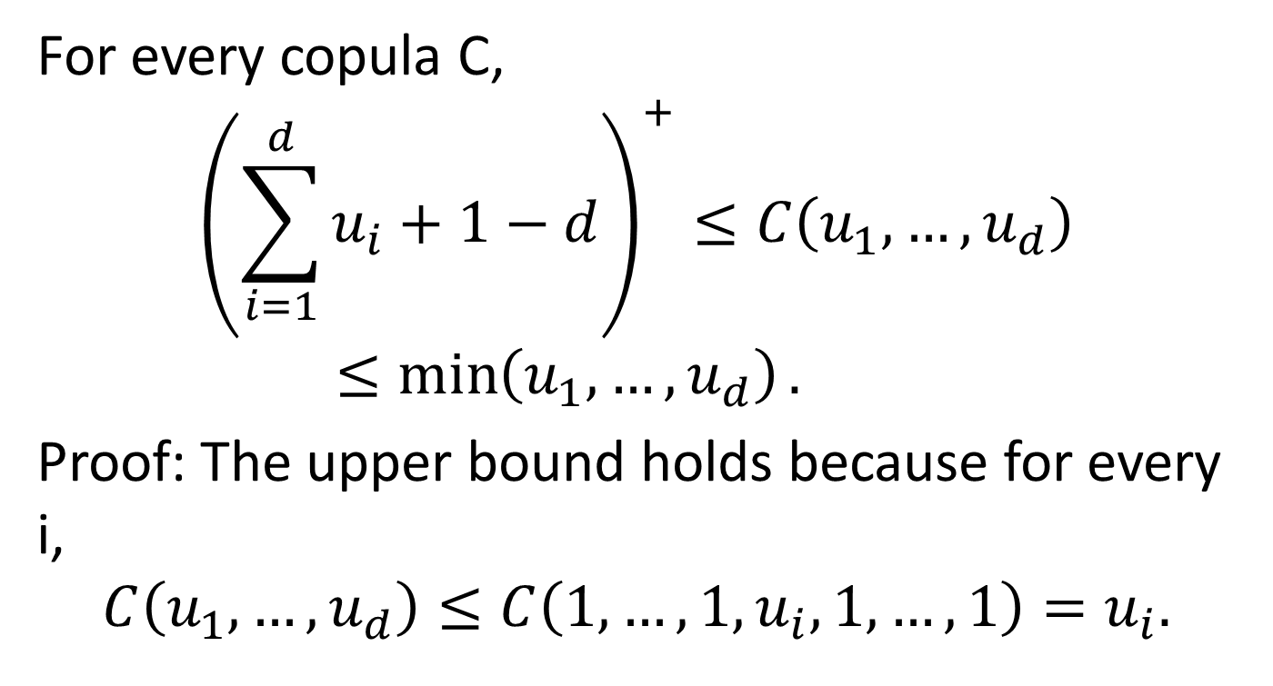
Upper and Lower Bounds
For every copula C,
$${\left(\sum_{i=1}^{d}{u_{i}}+1−d\right)}^{+}≤C\left(u_{1},…,u_{d}\right)≤\min\left(u_{1},…,u_{d}\right).$$
Proof: The upper bound holds because for every i,
$$C\left(u_{1},…,u_{d}\right)≤C\left(1,…,1,u_{i},1,…,1\right)=u_{i}.$$

Slide 19
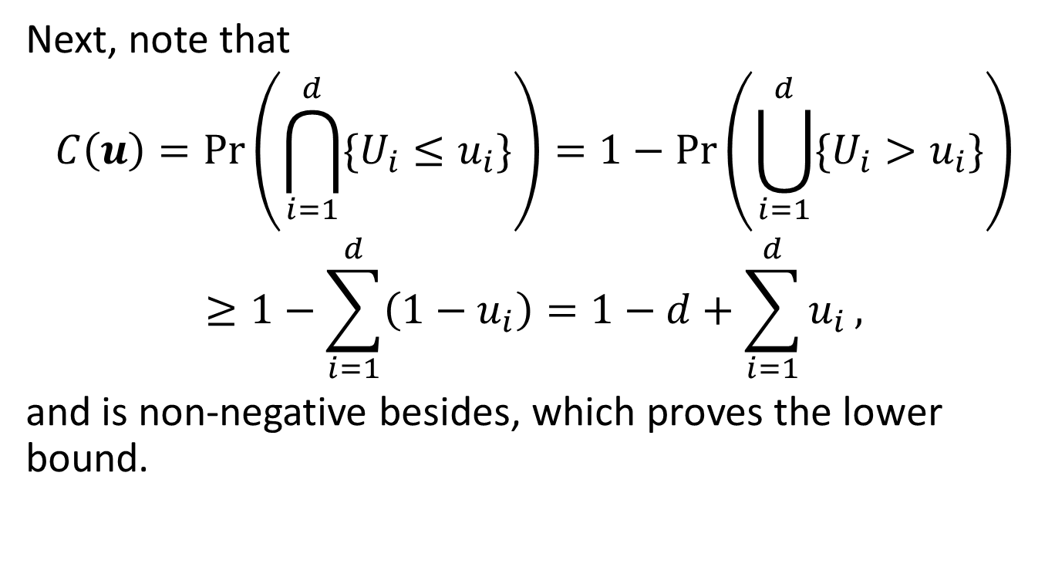
Upper and Lower Bounds, Cont’d
Next, note that
$$C\left(u\right)=\operatorname{Pr}\left(\bigcap_{i=1}^{d}{\{U_{i}≤u_{i}\}}\right)=1−\operatorname{Pr}\left(\bigcup_{i=1}^{d}{\{U_{i}>u_{i}\}}\right)$$
$$≥1−\sum_{i=1}^{d}{\left(1−u_{i}\right)}=1−d+\sum_{i=1}^{d}{u_{i}},$$
and is non-negative besides, which proves the lower bound.

Slide 20
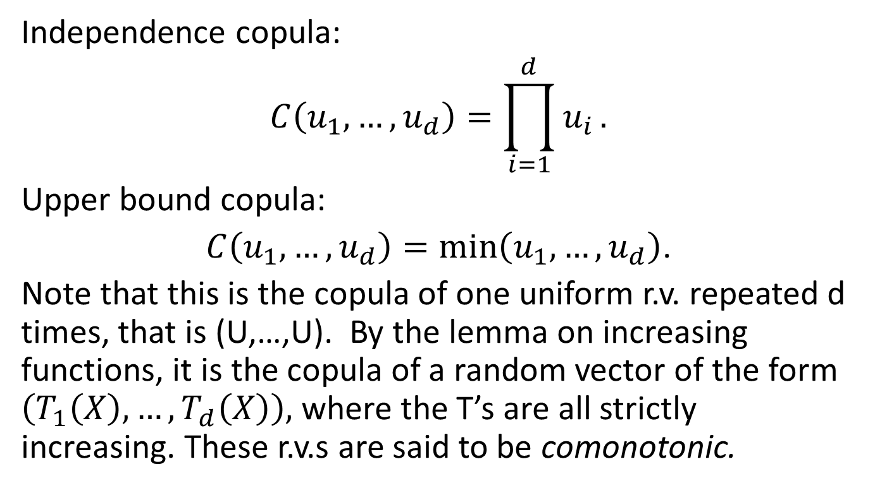
Examples of Copulas
Independence copula:
$$C\left(u_{1},…,u_{d}\right)=\prod_{i=1}^{d}{u_{i}}.$$
Upper bound copula:
$C\left(u_{1},…,u_{d}\right)=min⁡\left(u_{1},…,u_{d}\right)$.
Note that this is the copula of one uniform r.v. repeated d times, that is (U,…,U). By the lemma on increasing functions, it is the copula of a random vector of the form $\left(T_{1}\left(X\right),…,T_{d}\left(X\right)\right),$ where the T’s are all strictly increasing. These r.v.s are said to be comonotonic.

Slide 21
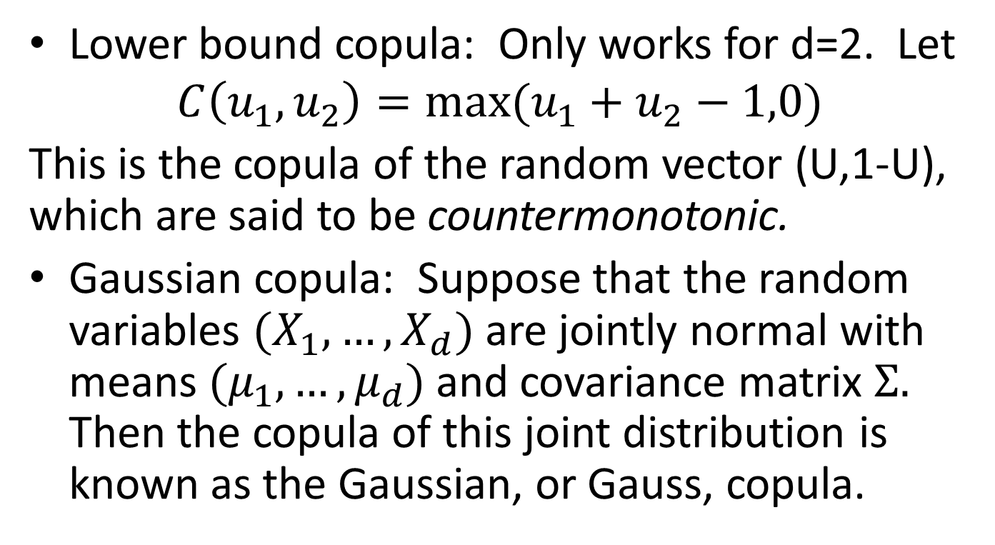
More Copula Examples
Lower bound copula: Only works for d=2. Let
$$C\left(u_{1},u_{2}\right)={max⁡(u}_{1}+u_{2}−1,0)$$
This is the copula of the random vector (U,1-U), which are said to be countermonotonic.
Gaussian copula: Suppose that the random variables $(X_{1},…,X_{d})$ are jointly normal with means $(μ_{1},…,μ_{d})$ and covariance matrix $Σ.$ Then the copula of this joint distribution is known as the Gaussian, or Gauss, copula.

Slide 22
More Copula Examples
Student t copula – A multivariate t distribution, constructed as a normal mixture, will have a unique copula.
The symmetric generalized hyperbolic distribution has a unique copula
Any multivariate distribution based on a normal mixture will have a copula

Slide 23
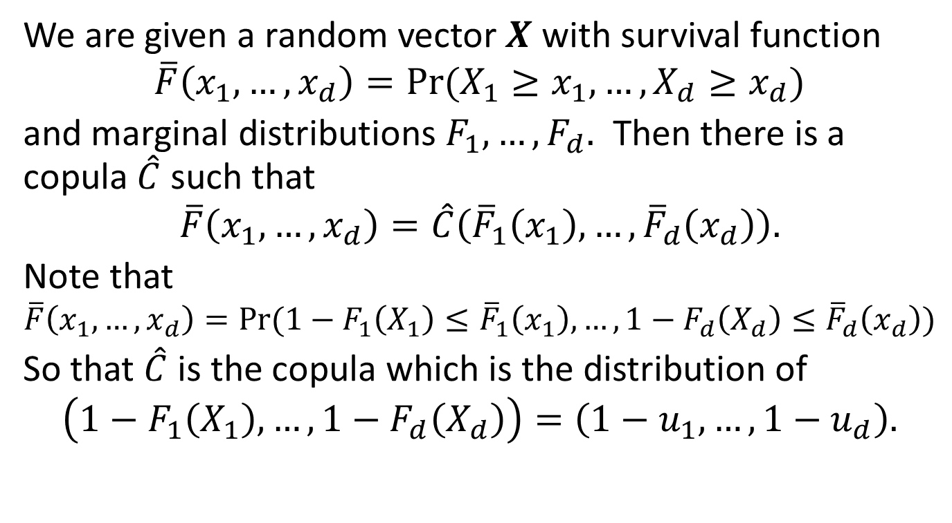
The Survival Copula
We are given a random vector $X$ with survival function
$$\overline{F}\left(x_{1},…,x_{d}\right)=Pr⁡(X_{1}≥x_{1},…,X_{d}≥x_{d})$$
and marginal distributions $F_{1},…,F_{d}.$ Then there is a copula $\hat{C}$ such that
$$\overline{F}\left(x_{1},…,x_{d}\right)=\hat{C}\left({\overline{F}}_{1}\left(x_{1}\right),…,{\overline{F}}_{d}\left(x_{d}\right)\right).$$
Note that
$$\overline{F}\left(x_{1},…,x_{d}\right)=Pr⁡(1−F_{1}\left(X_{1}\right)≤{\overline{F}}_{1}\left(x_{1}\right),…,1−F_{d}\left(X_{d}\right)≤{\overline{F}}_{d}\left(x_{d}\right))$$
So that $\hat{C}$ is the copula which is the distribution of
$$\left(1−F_{1}\left(X_{1}\right),…,1−F_{d}\left(X_{d}\right)\right)=\left(1−u_{1},…,1−u_{d}\right).$$

Slide 24
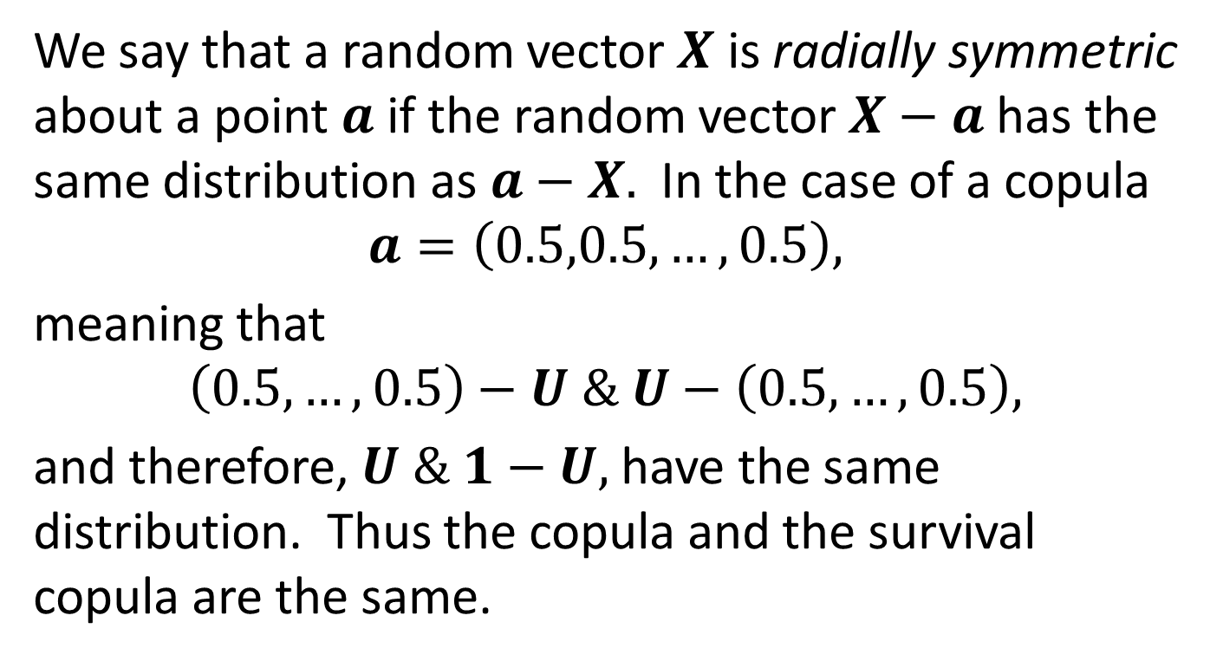
Radial Symmetry
We say that a random vector $X$ is radially symmetric about a point $a$ if the random vector $X−a$ has the same distribution as $a−X.$ In the case of a copula
$$a=\left(0.5,0.5,…,0.5\right),$$
meaning that
$$\left(0.5,…,0.5\right)−U \& U−\left(0.5,…,0.5\right),$$
and therefore, $U \& 1−U,$ have the same distribution. Thus the copula and the survival copula are the same.

Slide 25
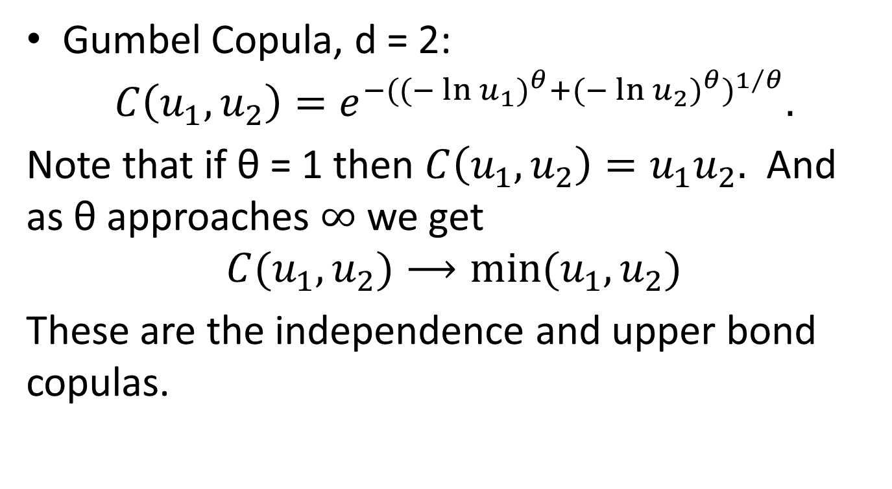
More Explicit Copulas
Gumbel Copula, d = 2:
$$C\left(u_{1},u_{2}\right)=e^{−{({(−\ln{u_{1})}}^{θ}+{(−\ln{u_{2})}}^{θ})}^{1/θ}}.$$
Note that if θ = 1 then $C\left(u_{1},u_{2}\right)=u_{1}u_{2}.$ And as θ approaches $∞$ we get
$$C(u_{1},u_{2})⟶min⁡(u_{1},u_{2})$$
These are the independence and upper bond copulas.

Slide 26
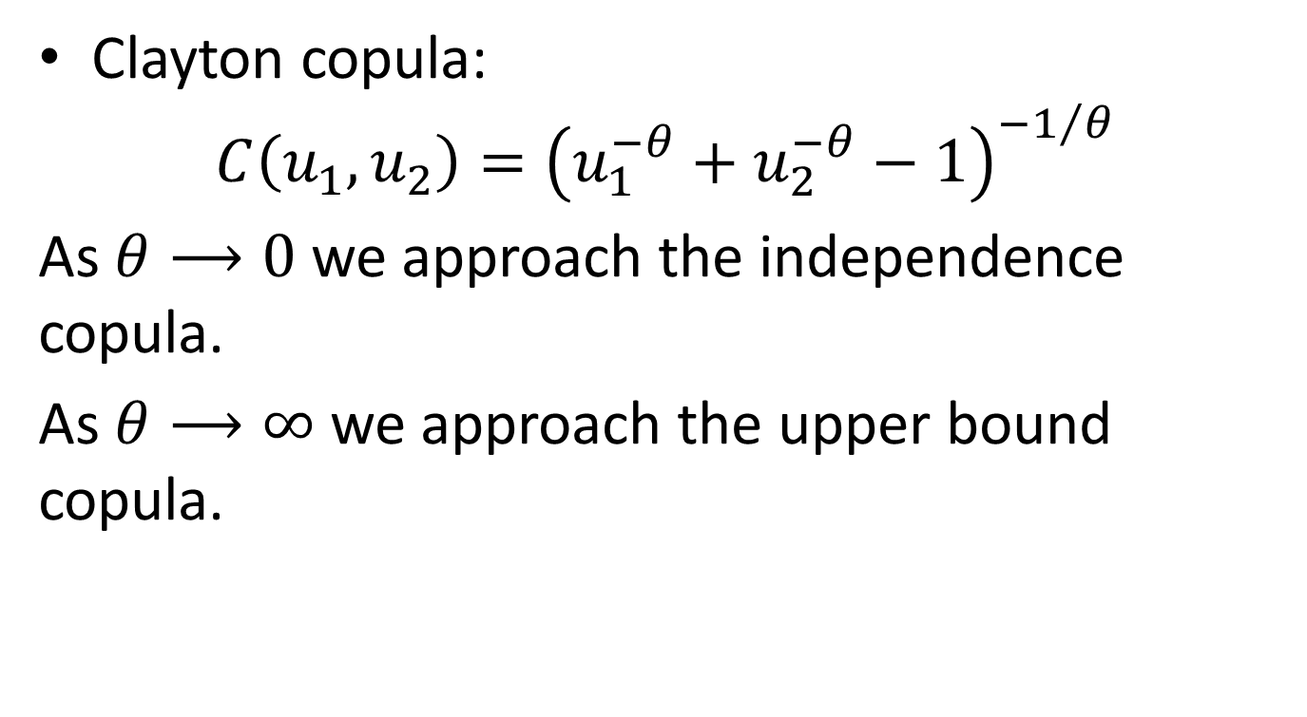
Explicit Copulas, Cont’d
Clayton copula:
$$C\left(u_{1},u_{2}\right)={\left(u_{1}^{−θ}+u_{2}^{−θ}−1\right)}^{−1/θ}$$
As $θ⟶0$ we approach the independence copula.
As $θ⟶∞$ we approach the upper bound copula.

Slide 27
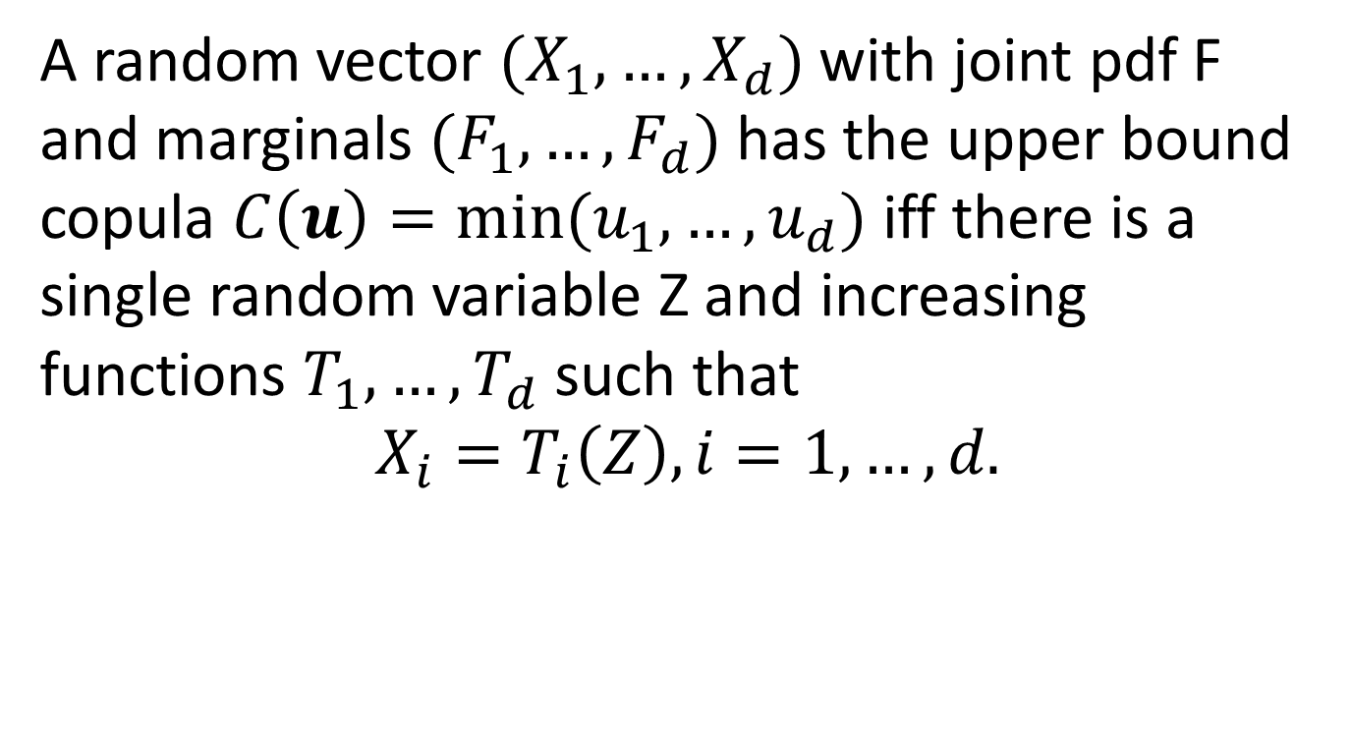
Comonotonicity Theorem
A random vector $(X_{1},…,X_{d})$ with joint pdf F and marginals $(F_{1},…,F_{d})$ has the upper bound copula $C\left(u\right)=min⁡(u_{1},…,u_{d})$ iff there is a single random variable Z and increasing functions $T_{1},…,T_{d}$ such that
$$X_{i}=T_{i}\left(Z\right),i=1,…,d.$$

Slide 28
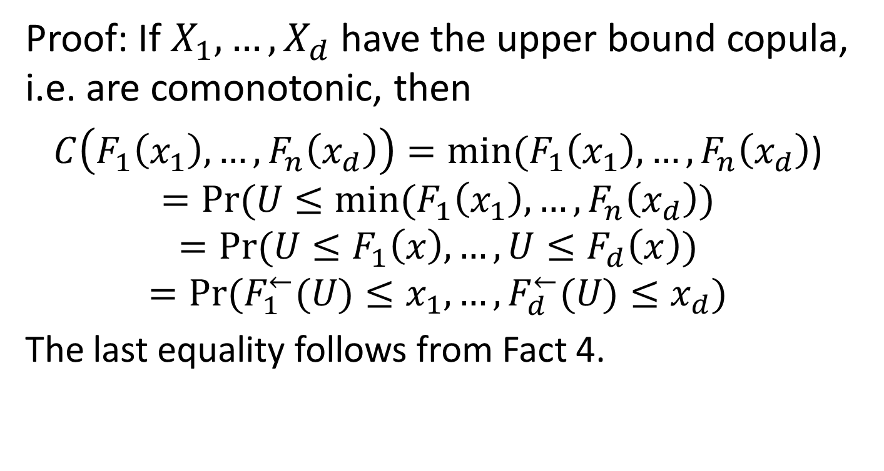
Comonotonicity Theorem, Cont’d
Proof: If $X_{1},…,X_{d}$ have the upper bound copula, i.e. are comonotonic, then
$C\left(F_{1}\left(x_{1}\right),…,F_{n}\left(x_{d}\right)\right)=min⁡(F_{1}\left(x_{1}\right),…,F_{n}\left(x_{d}\right)$)
$$=Pr⁡(U≤min⁡(F_{1}\left(x_{1}\right),…,F_{n}\left(x_{d}\right))$$
$$=Pr⁡(U≤F_{1}\left(x\right),…,U≤F_{d}\left(x\right))$$
$$=Pr⁡(F_{1}^{←}(U)≤x_{1},…,F_{d}^{←}(U)≤x_{d})$$
The last equality follows from Fact 4.

Slide 29
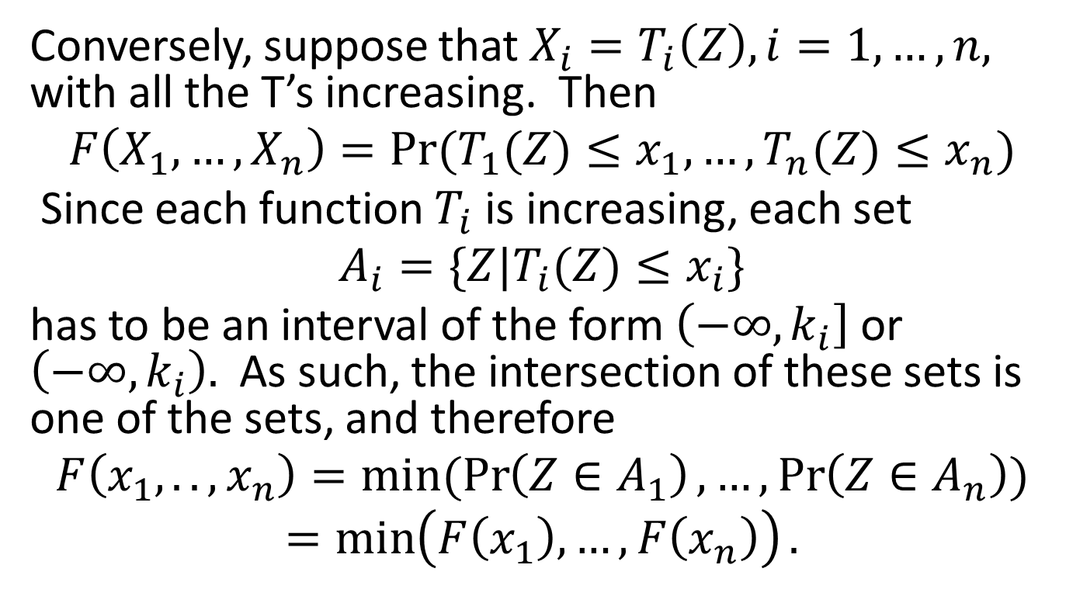
Comonotonicity Theorem, Cont’d
Conversely, suppose that $X_{i}=T_{i}\left(Z\right),i=1,…,n,$ with all the T’s increasing. Then
$$F\left(X_{1},…,X_{n}\right)=Pr⁡(T_{1}(Z)≤x_{1},…,T_{n}(Z)≤x_{n})$$
Since each function $T_{i}$ is increasing, each set
$$A_{i}=\{Z|T_{i}(Z)≤x_{i}\}$$
has to be an interval of the form $\left(−∞,k_{i}\right]$ or $\left(−∞,k_{i}\right).$ As such, the intersection of these sets is one of the sets, and therefore
$$F\left(x_{1},..,x_{n}\right)=min⁡(\operatorname{Pr}\left(Z∈A_{1}\right),…,\operatorname{Pr}\left(Z∈A_{n}\right))$$
$$=\min\left(F\left(x_{1}\right),…,F\left(x_{n}\right)\right).$$

Slide 30
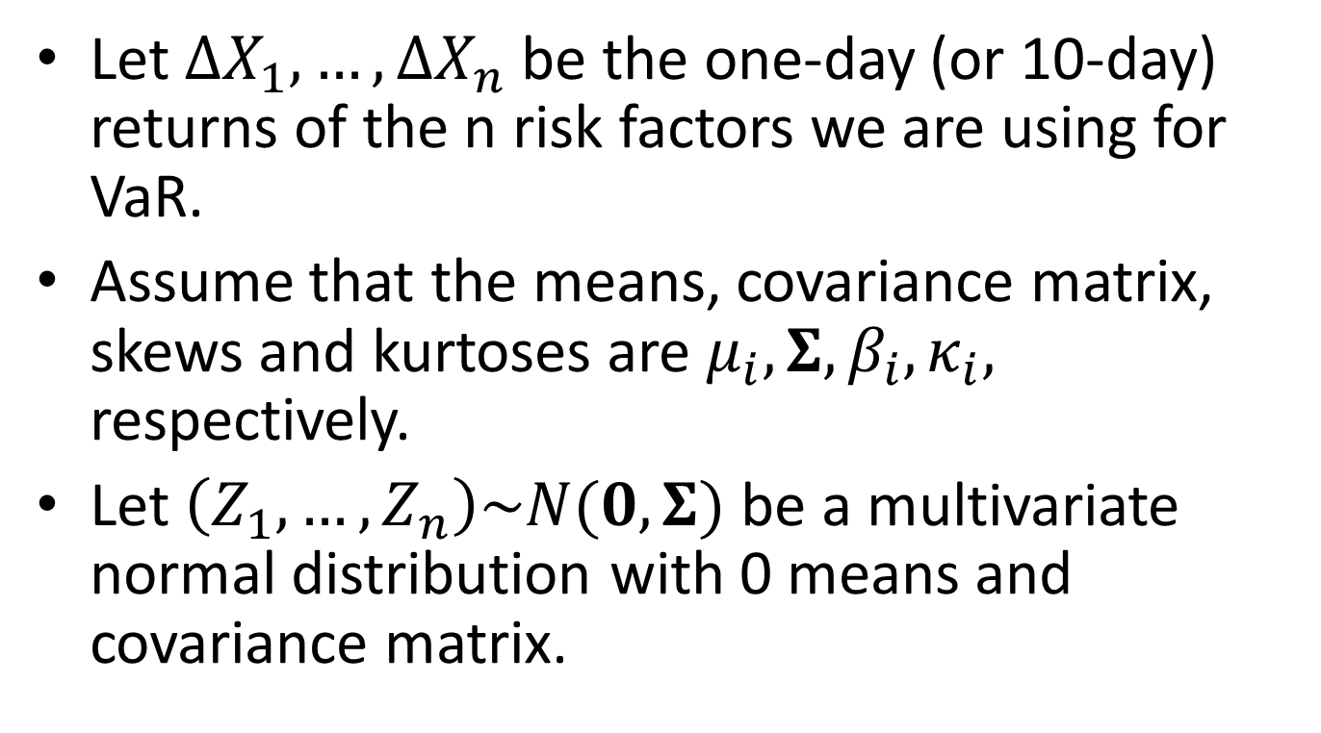
Using a Copula to Improve Your Monte Carlo VaR Model – A Recipe
Let $∆X_{1},…,∆X_{n}$ be the one-day (or 10-day) returns of the n risk factors we are using for VaR.
Assume that the means, covariance matrix, skews and kurtoses are $μ_{i},Σ, β_{i},κ_{i},$ respectively.
Let $\left(Z_{1},…,Z_{n}\right)\sim N(0,Σ)$ be a multivariate normal distribution with 0 means and covariance matrix.

Slide 31
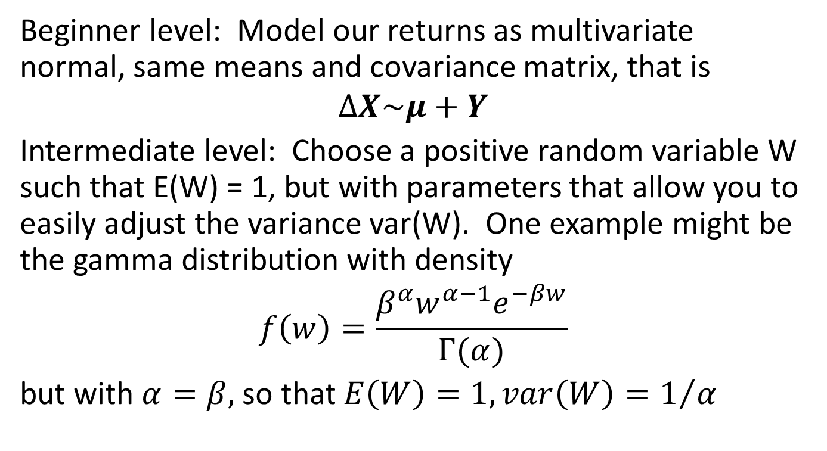
The Recipe, Cont’d
Beginner level: Model our returns as multivariate normal, same means and covariance matrix, that is
$$ΔX\sim μ+Y$$
Intermediate level: Choose a positive random variable W such that E(W) = 1, but with parameters that allow you to easily adjust the variance var(W). One example might be the gamma distribution with density
$$f\left(w\right)=\frac{β^{α}w^{α−1}e^{−βw}}{Γ(α)}$$
but with $α=β,$ so that $E\left(W\right)=1, var\left(W\right)=1/α$

Slide 32
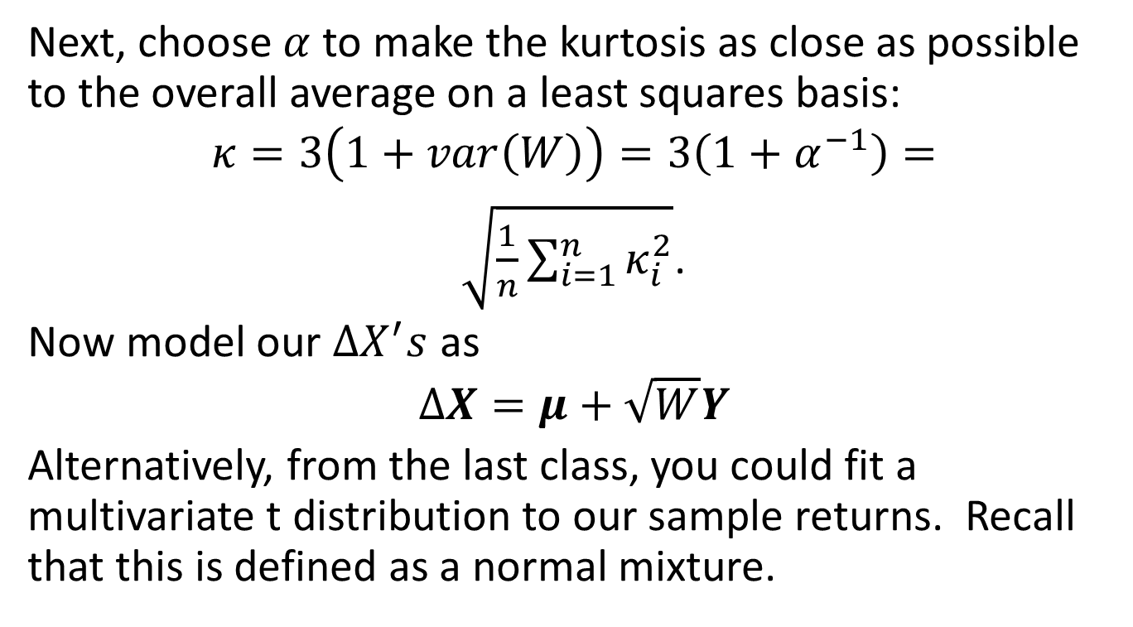
The Recipe, Cont’d
Next, choose $α$to make the kurtosis as close as possible to the overall average on a least squares basis:
$$κ=3\left(1+var\left(W\right)\right)=3\left(1+α^{−1}\right)=$$
$\sqrt{\frac{1}{n}\sum_{i=1}^{n}{κ_{i}^{2}}}$.
Now model our $ΔX^{′}s$ as
$$ΔX=μ+\sqrt{W}Y$$
Alternatively, from the last class, you could fit a multivariate t distribution to our sample returns. Recall that this is defined as a normal mixture.

Slide 33
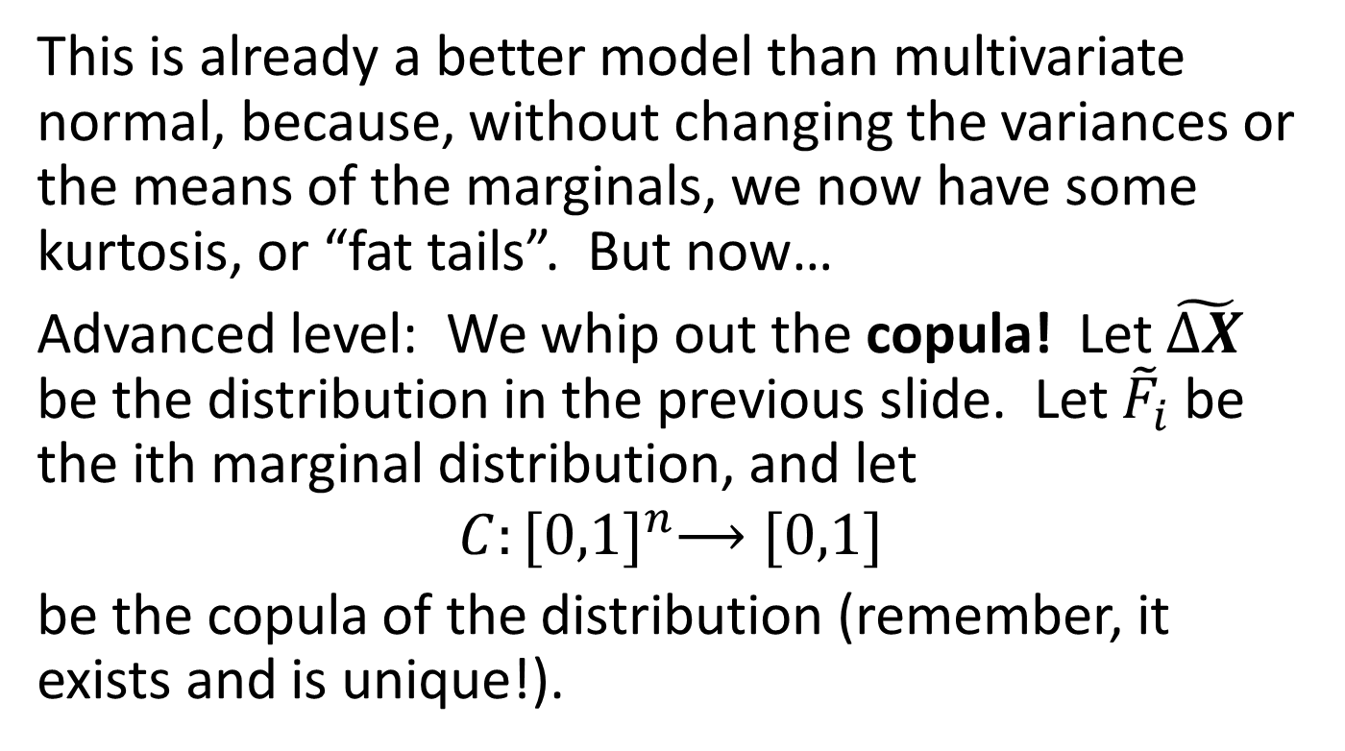
The Recipe, Cont’d
This is already a better model than multivariate normal, because, without changing the variances or the means of the marginals, we now have some kurtosis, or “fat tails”. But now…
Advanced level: We whip out the copula! Let $\tilde{ΔX}$ be the distribution in the previous slide. Let ${\tilde{F}}_{i}$ be the ith marginal distribution, and let
$$C:{[0,1]}^{n}⟶[0,1]$$
be the copula of the distribution (remember, it exists and is unique!).

Slide 34
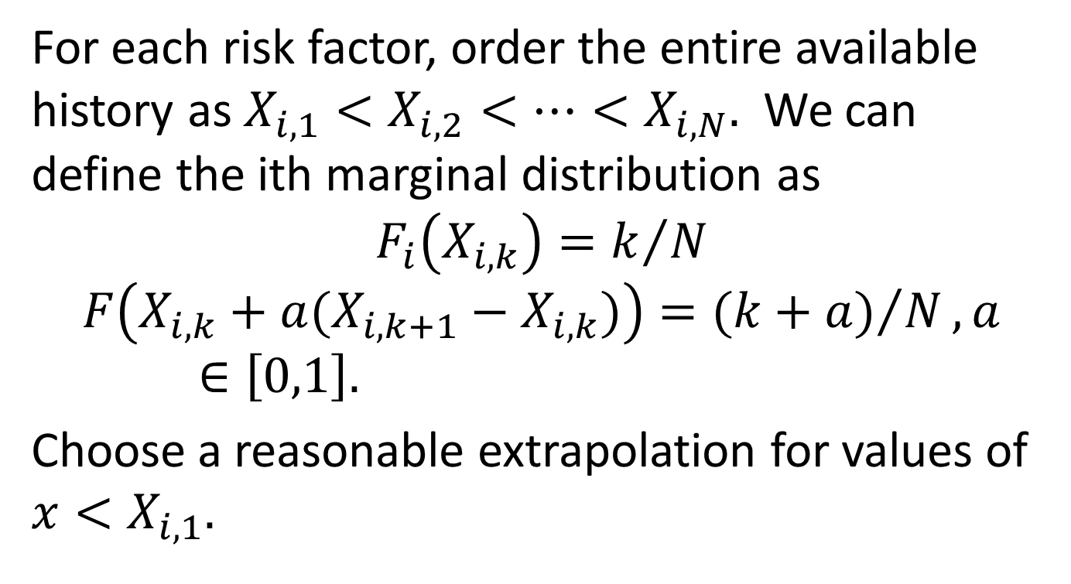
Filling out the Marginals
For each risk factor, order the entire available history as $X_{i,1}<X_{i,2}<…<X_{i,N}.$ We can define the ith marginal distribution as
$$F_{i}\left(X_{i,k}\right)=k/N$$
$$F\left(X_{i,k}+a(X_{i,k+1}−X_{i,k})\right)={(k+a)}/N,a∈\left[0,1\right].$$
Choose a reasonable extrapolation for values of $x<X_{i,1}.$

Slide 35
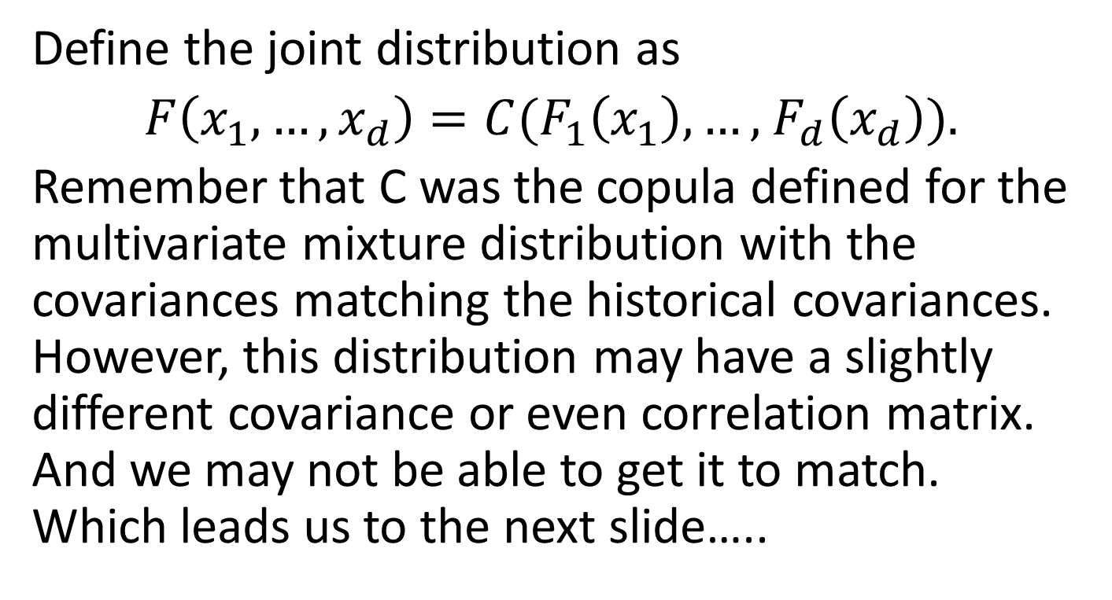
Finally…
Define the joint distribution as
$F\left(x_{1},…,x_{d}\right)=C(F_{1}\left(x_{1}\right),…,$ $F_{d}\left(x_{d}\right)).$
Remember that C was the copula defined for the multivariate mixture distribution with the covariances matching the historical covariances. However, this distribution may have a slightly different covariance or even correlation matrix. And we may not be able to get it to match. Which leads us to the next slide…..

Slide 36
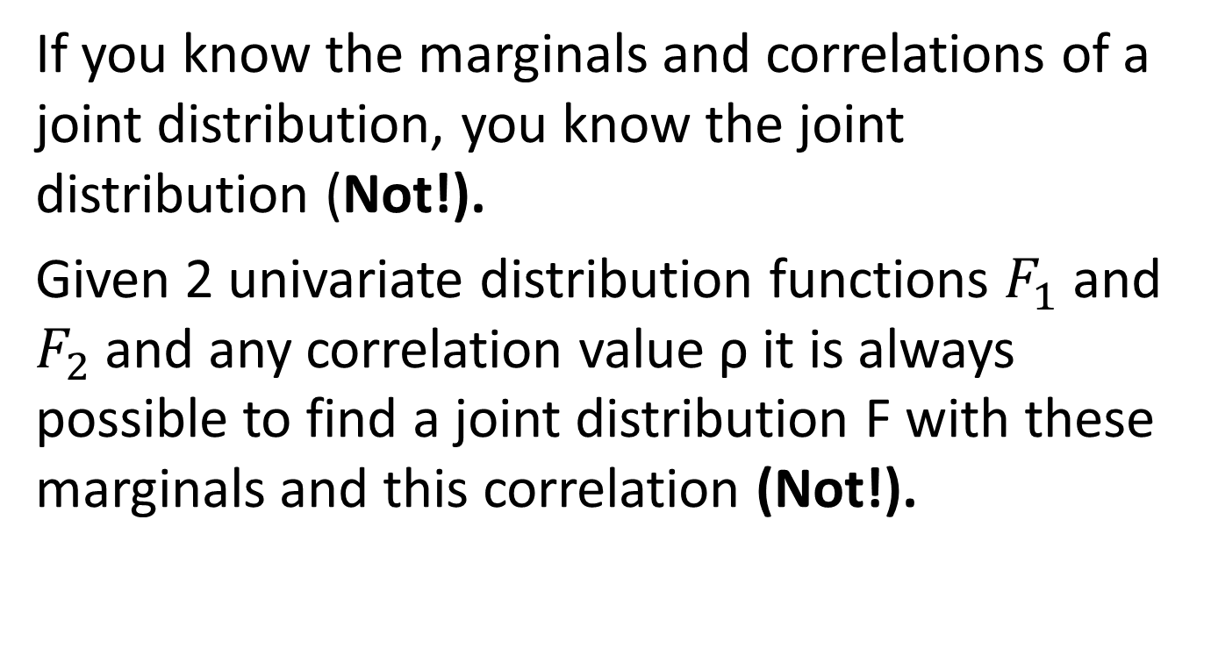
2 Fallacies on Correlation
If you know the marginals and correlations of a joint distribution, you know the joint distribution (Not!).
Given 2 univariate distribution functions $F_{1}$ and $F_{2}$ and any correlation value ρ it is always possible to find a joint distribution F with these marginals and this correlation (Not!).

Slide 37
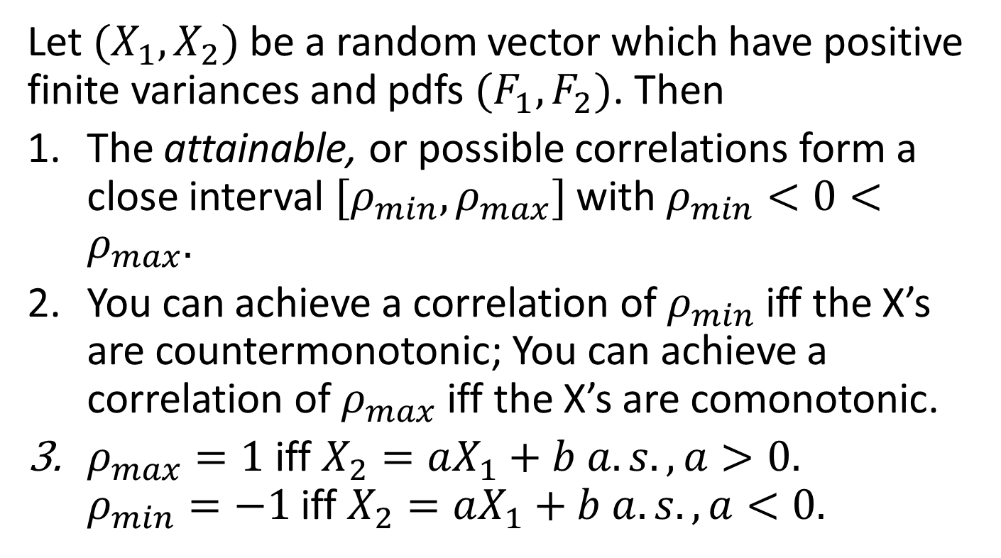
Attainable Correlations
Let $(X_{1},X_{2})$ be a random vector which have positive finite variances and pdfs $(F_{1},F_{2})$. Then
The attainable, or possible correlations form a close interval ${[ρ}_{min},ρ_{max}]$ with $ρ_{min}<0<ρ_{max}.$
You can achieve a correlation of $ρ_{min}$ iff the X’s are countermonotonic; You can achieve a correlation of $ρ_{max}$ iff the X’s are comonotonic.
$ρ_{max}=1$ iff $X_{2}=aX_{1}+b a.s., a>0.$ $ρ_{min}=−1$ iff $X_{2}=aX_{1}+b a.s., a<0.$

Slide 38
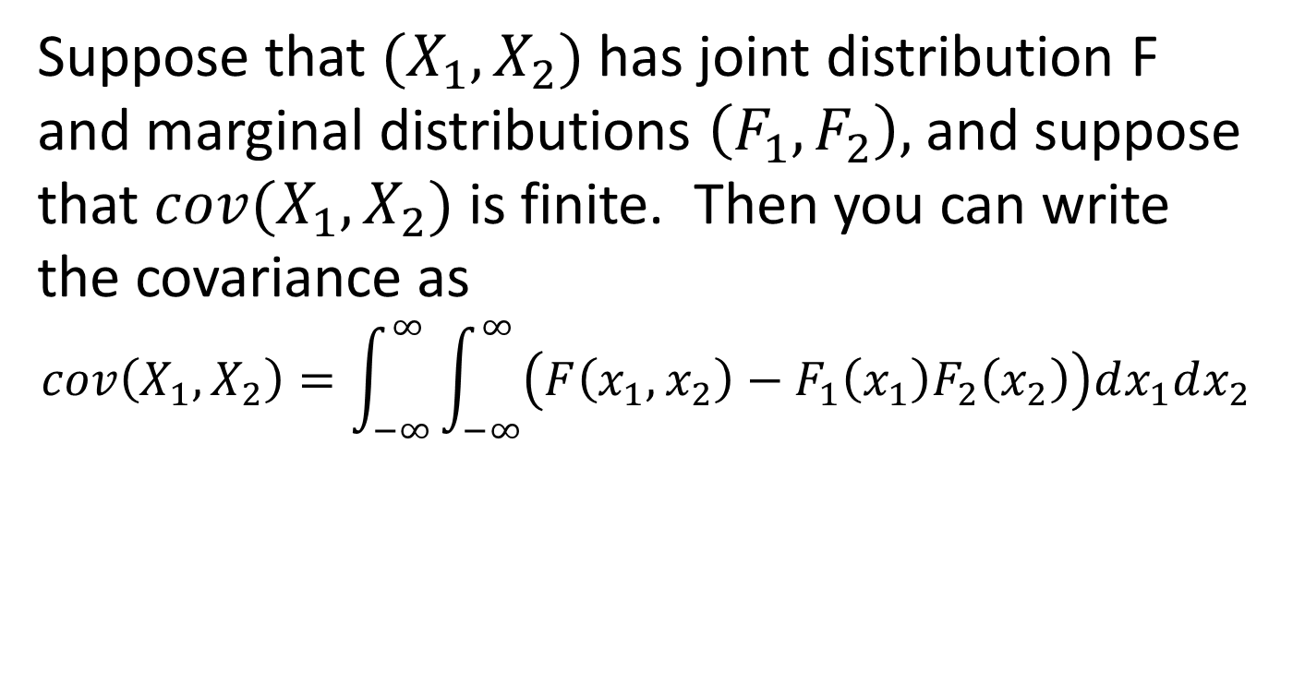
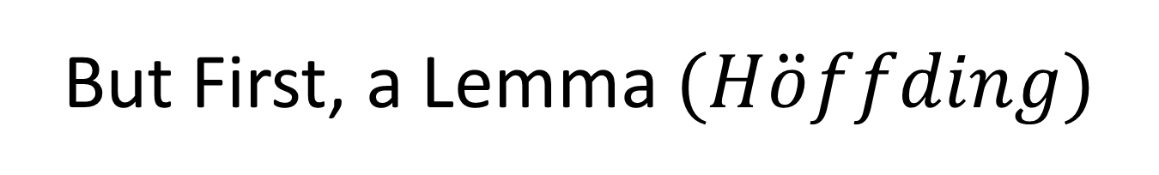
But First, a Lemma $(H\ddot{o}ffding)$
Suppose that $(X_{1},X_{2})$ has joint distribution F and marginal distributions $\left(F_{1},F_{2}\right),$ and suppose that $cov(X_{1},X_{2})$ is finite. Then you can write the covariance as
$$cov\left(X_{1},X_{2}\right)=\int_{−∞}^{∞}{\int_{−∞}^{∞}{\left(F\left(x_{1},x_{2}\right)−F_{1}\left(x_{1}\right)F_{2}\left(x_{2}\right)\right)dx_{1}dx_{2}}}$$

Slide 39
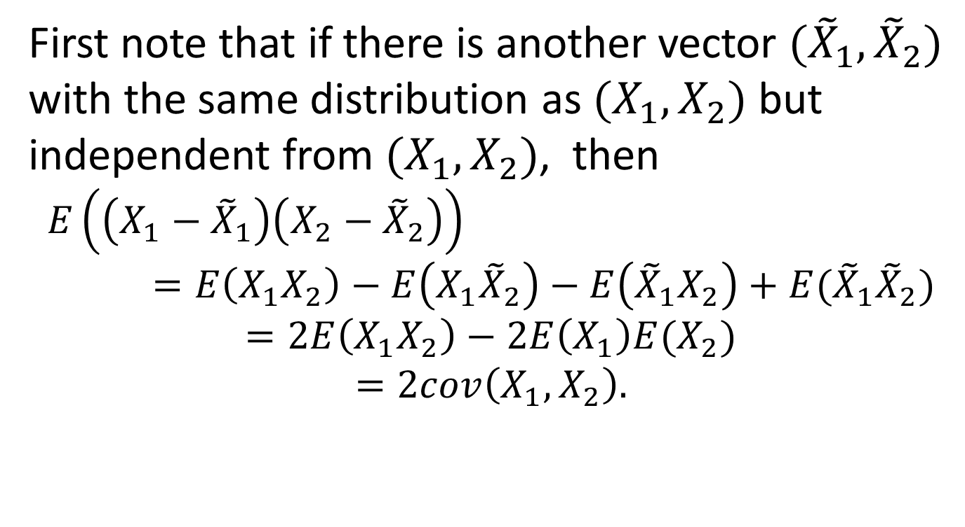
Proof of the Lemma
First note that if there is another vector $({\tilde{X}}_{1},{\tilde{X}}_{2})$ with the same distribution as $(X_{1},X_{2})$ but independent from $(X_{1},X_{2})$, then
$$E\left(\left(X_{1}−{\tilde{X}}_{1}\right)\left(X_{2}−{\tilde{X}}_{2}\right)\right)=E\left(X_{1}X_{2}\right)−E\left(X_{1}{\tilde{X}}_{2}\right)−E\left({\tilde{X}}_{1}X_{2}\right)+E({\tilde{X}}_{1}{\tilde{X}}_{2})$$
$$=2E\left(X_{1}X_{2}\right)−2E\left(X_{1}\right)E(X_{2})$$
$$=2cov\left(X_{1},X_{2}\right).$$

Slide 40
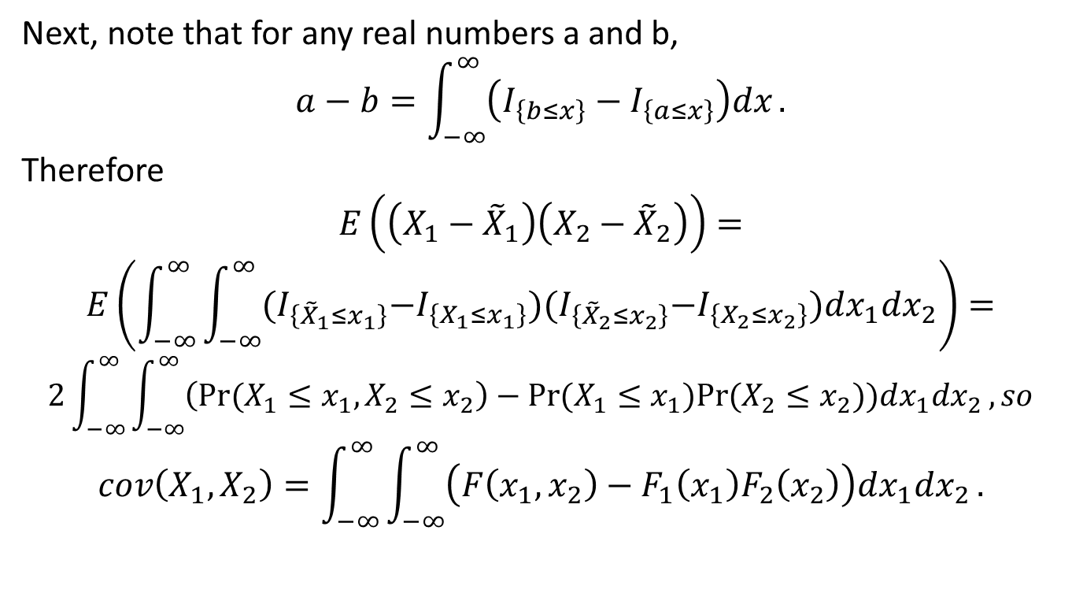
Proof of the Lemma, Cont’d
Next, note that for any real numbers a and b,
$$a−b=\int_{−∞}^{∞}{\left(I_{\left\{b≤x\right\}}−I_{\left\{a≤x\right\}}\right)dx}.$$
Therefore
$$E\left(\left(X_{1}−{\tilde{X}}_{1}\right)\left(X_{2}−{\tilde{X}}_{2}\right)\right)=$$
$$E\left(\int_{−∞}^{∞}{\int_{−∞}^{∞}{{(I}_{\left\{{\tilde{X}}_{1}≤x_{1}\right\}}−I_{\left\{X_{1}≤x_{1}\right\}}){(I}_{\left\{{\tilde{X}}_{2}≤x_{2}\right\}}−I_{\left\{X_{2}≤x_{2}\right\}})dx_{1}dx_{2}}}\right)=$$
$$2\int_{−∞}^{∞}{\int_{−∞}^{∞}{\left(Pr⁡(X_{1}≤x_{1},X_{2}≤x_{2}\right)−Pr⁡(X_{1}≤x_{1})Pr⁡(X_{2}≤x_{2}))dx_{1}dx_{2}}}, so$$
$$cov\left(X_{1},X_{2}\right)=\int_{−∞}^{∞}{\int_{−∞}^{∞}{\left(F\left(x_{1},x_{2}\right)−F_{1}\left(x_{1}\right)F_{2}\left(x_{2}\right)\right)dx_{1}dx_{2}}}.$$

Slide 41
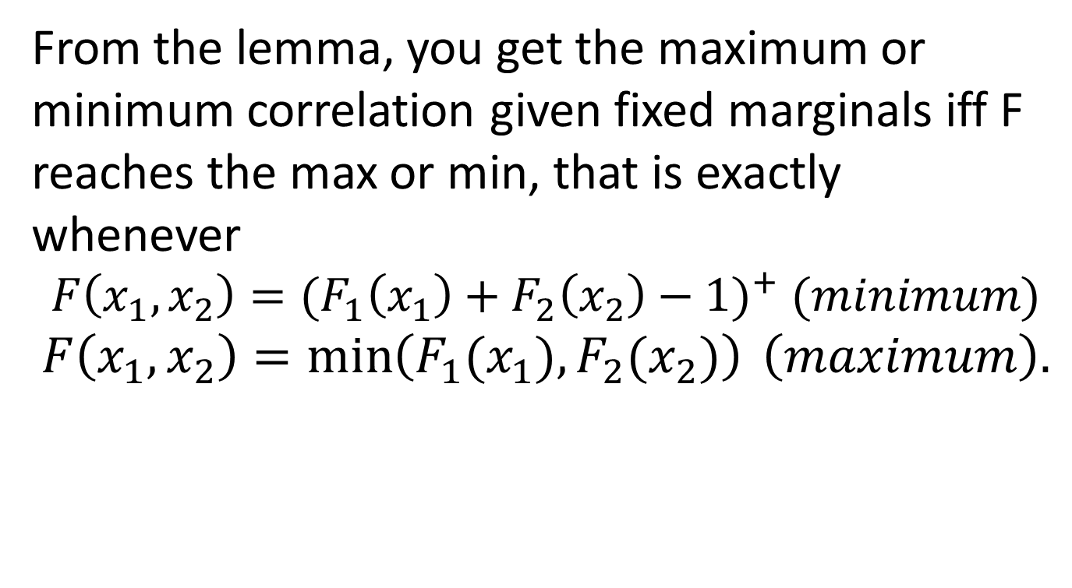
Attainable Correlations, Proof
From the lemma, you get the maximum or minimum correlation given fixed marginals iff F reaches the max or min, that is exactly whenever
$$F\left(x_{1},x_{2}\right)={(F_{1}\left(x_{1}\right)+F_{2}\left(x_{2}\right)−1)}^{+} (minimum)$$
$$F\left(x_{1},x_{2}\right)=\min\left(F_{1}(x_{1}),F_{2}(x_{2})\right) \left(maximum\right).$$

Slide 42
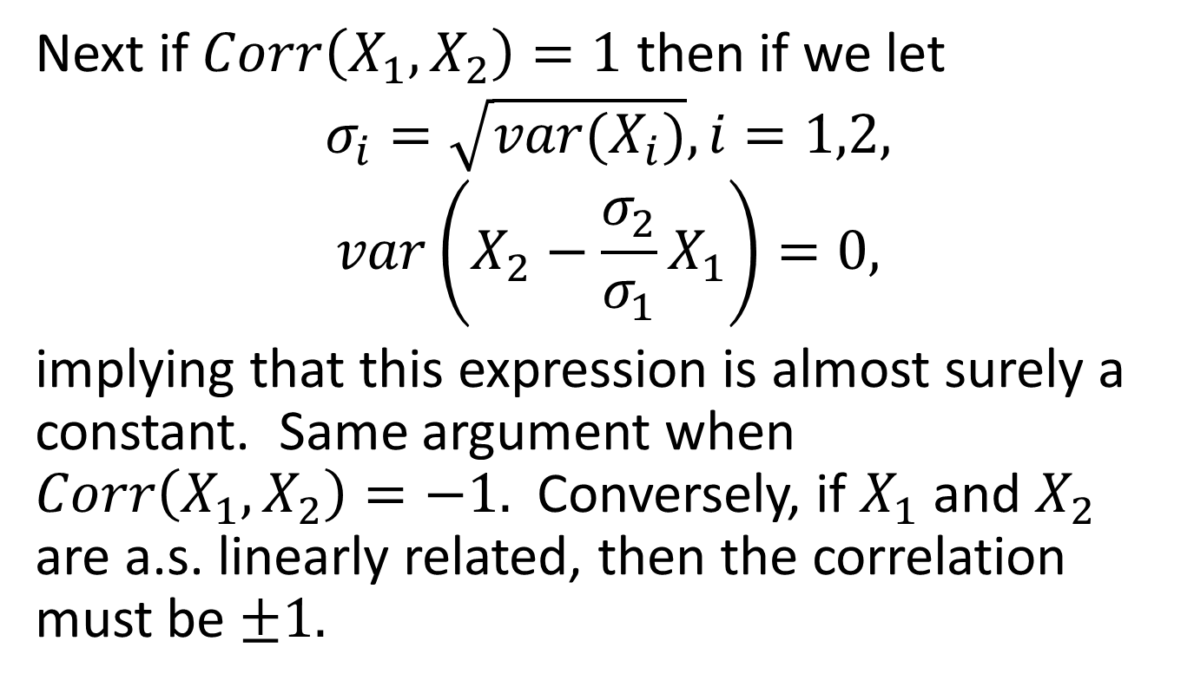
Attainable Correlations, Cont’d
Next if $Corr\left(X_{1},X_{2}\right)=1$ then if we let
$$σ_{i}=\sqrt{var(X_{i})}, i=1,2,$$
$$var\left(X_{2}−\frac{σ_{2}}{σ_{1}}X_{1}\right)=0,$$
implying that this expression is almost surely a constant. Same argument when $Corr\left(X_{1},X_{2}\right)=−1.$ Conversely, if $X_{1}$ and $X_{2}$ are a.s. linearly related, then the correlation must be $±1.$

Slide 43
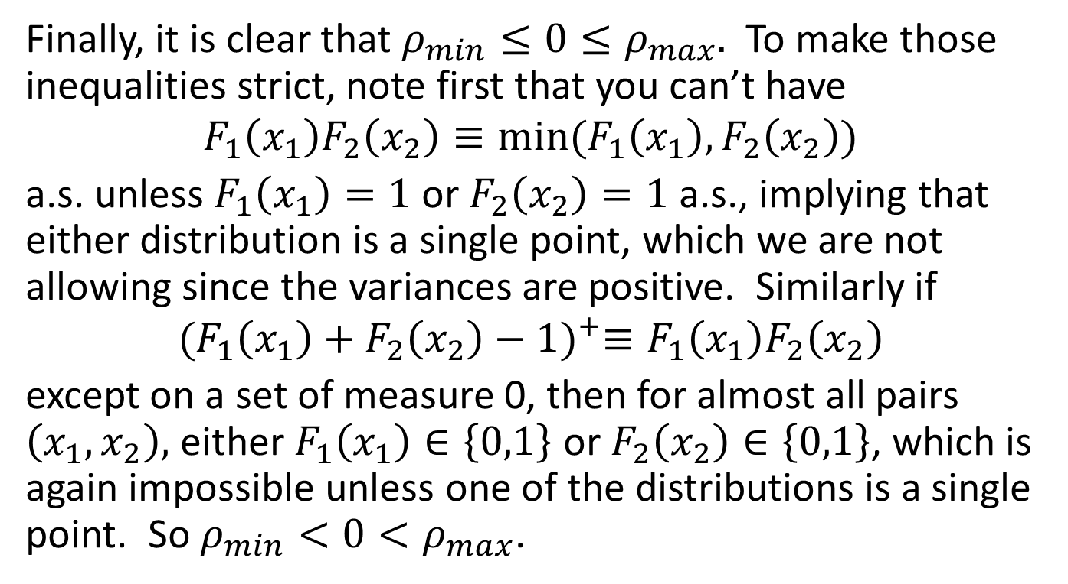
Attainable Correlations, Cont’d
Finally, it is clear that $ρ_{min}≤0≤ρ_{max}.$ To make those inequalities strict, note first that you can’t have
$$F_{1}\left(x_{1}\right)F_{2}\left(x_{2}\right)≡min⁡(F_{1}\left(x_{1}\right),F_{2}\left(x_{2}\right))$$
a.s. unless $F_{1}\left(x_{1}\right)=1$or $F_{2}\left(x_{2}\right)=1$ a.s., implying that either distribution is a single point, which we are not allowing since the variances are positive. Similarly if
$${(F_{1}\left(x_{1}\right)+F_{2}\left(x_{2}\right)−1)}^{+}≡F_{1}\left(x_{1}\right)F_{2}\left(x_{2}\right)$$
except on a set of measure 0, then for almost all pairs $\left(x_{1},x_{2}\right),$ either $F_{1}\left(x_{1}\right)∈\left\{0,1\right\}$ or $F_{2}\left(x_{2}\right)∈\left\{0,1\right\}$, which is again impossible unless one of the distributions is a single point. So $ρ_{min}<0<ρ_{max}$.

Slide 44
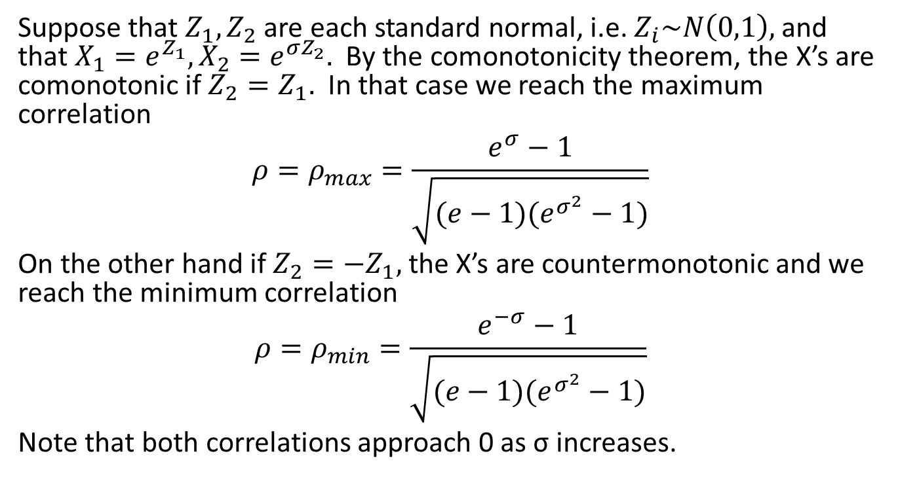
An Example
Suppose that $Z_{1},Z_{2}$ are each standard normal, i.e. $Z_{i}\sim N\left(0,1\right),$ and that $X_{1}=e^{Z_{1}}, X_{2}=e^{σZ_{2}}.$ By the comonotonicity theorem, the X’s are comonotonic if $Z_{2}=Z_{1}.$ In that case we reach the maximum correlation
$$ρ=ρ_{max}=\frac{e^{σ}−1}{\sqrt{(e−1)(e^{σ^{2}}−1)}}$$
On the other hand if $Z_{2}=−Z_{1},$ the X’s are countermonotonic and we reach the minimum correlation
$$ρ=ρ_{min}=\frac{e^{−σ}−1}{\sqrt{(e−1)(e^{σ^{2}}−1)}}$$
Note that both correlations approach 0 as σ increases.

Slide 45
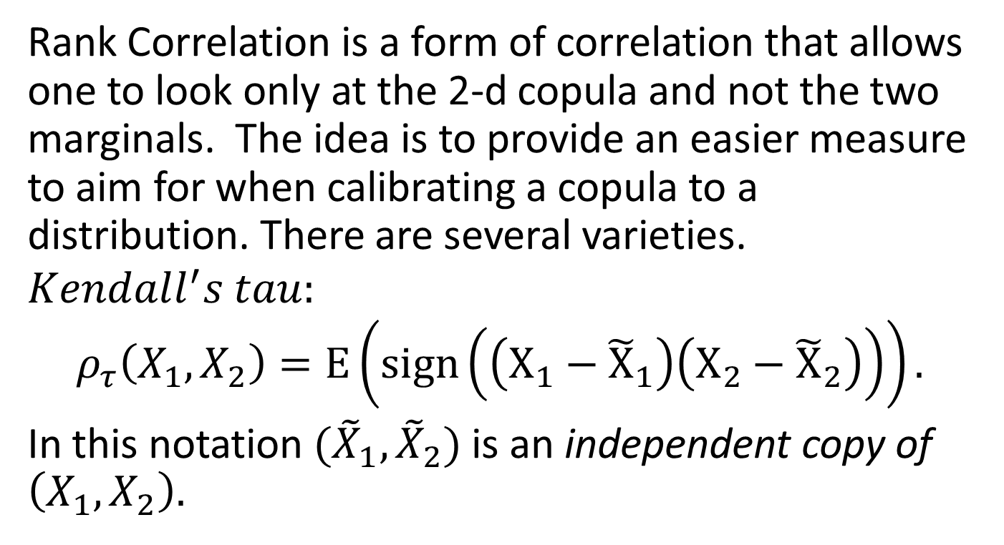
Rank Correlation
Rank Correlation is a form of correlation that allows one to look only at the 2-d copula and not the two marginals. The idea is to provide an easier measure to aim for when calibrating a copula to a distribution. There are several varieties.
$$Kendall^{′}s tau:$$
$$ρ_{τ}\left(X_{1},X_{2}\right)=E\left(sign\left(\left(X_{1}−{\tilde{X}}_{1}\right)\left(X_{2}−{\tilde{X}}_{2}\right)\right)\right).$$
In this notation $({\tilde{X}}_{1},{\tilde{X}}_{2})$ is an independent copy of $\left(X_{1},X_{2}\right).$

Slide 46
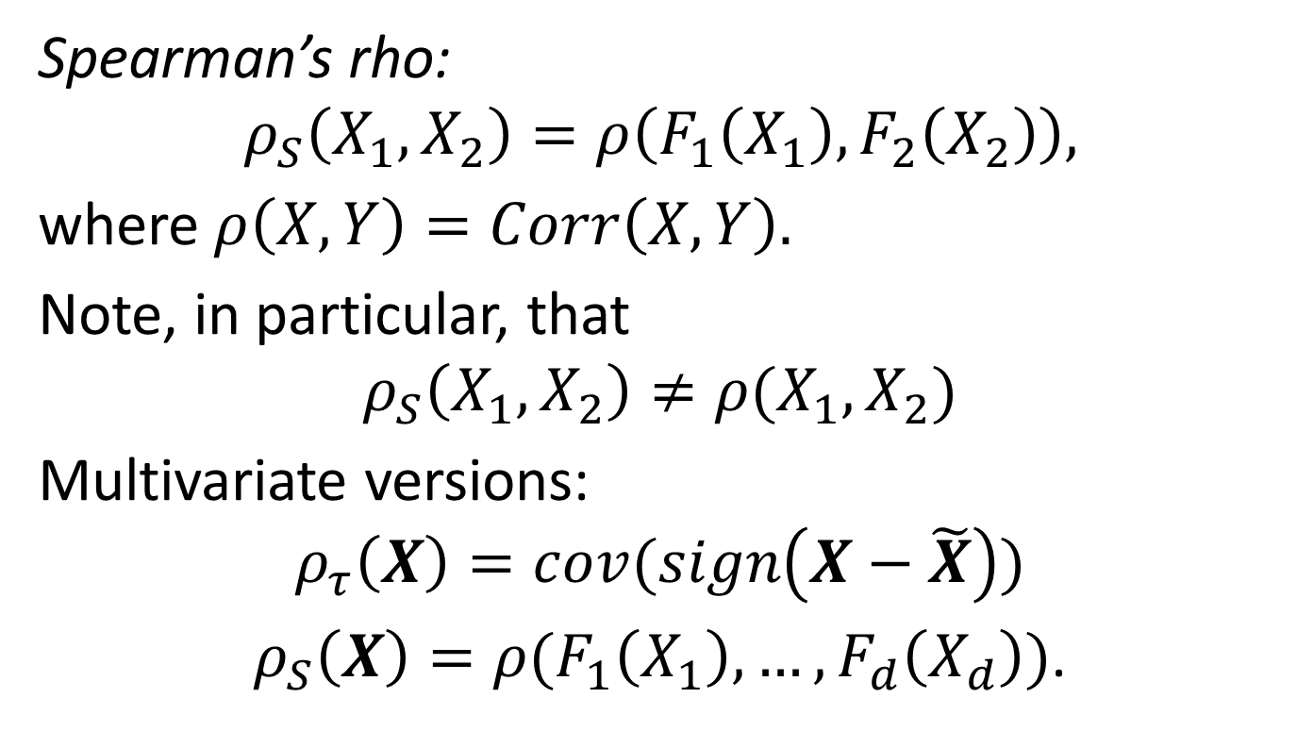
Rank Correlation, cont’d
Spearman’s rho:
$$ρ_{S}\left(X_{1},X_{2}\right)=ρ\left(F_{1}\left(X_{1}\right),F_{2}\left(X_{2}\right)\right),$$
where $ρ\left(X,Y\right)=Corr\left(X,Y\right).$
Note, in particular, that
$$ρ_{S}\left(X_{1},X_{2}\right)≠ρ(X_{1},X_{2})$$
Multivariate versions:
$$ρ_{τ}\left(X\right)=cov(sign\left(X−\tilde{X}\right))$$
$ρ_{S}\left(X\right)=ρ(F_{1}\left(X_{1}\right),…,F_{d}\left(X_{d}\right))$.

Slide 47
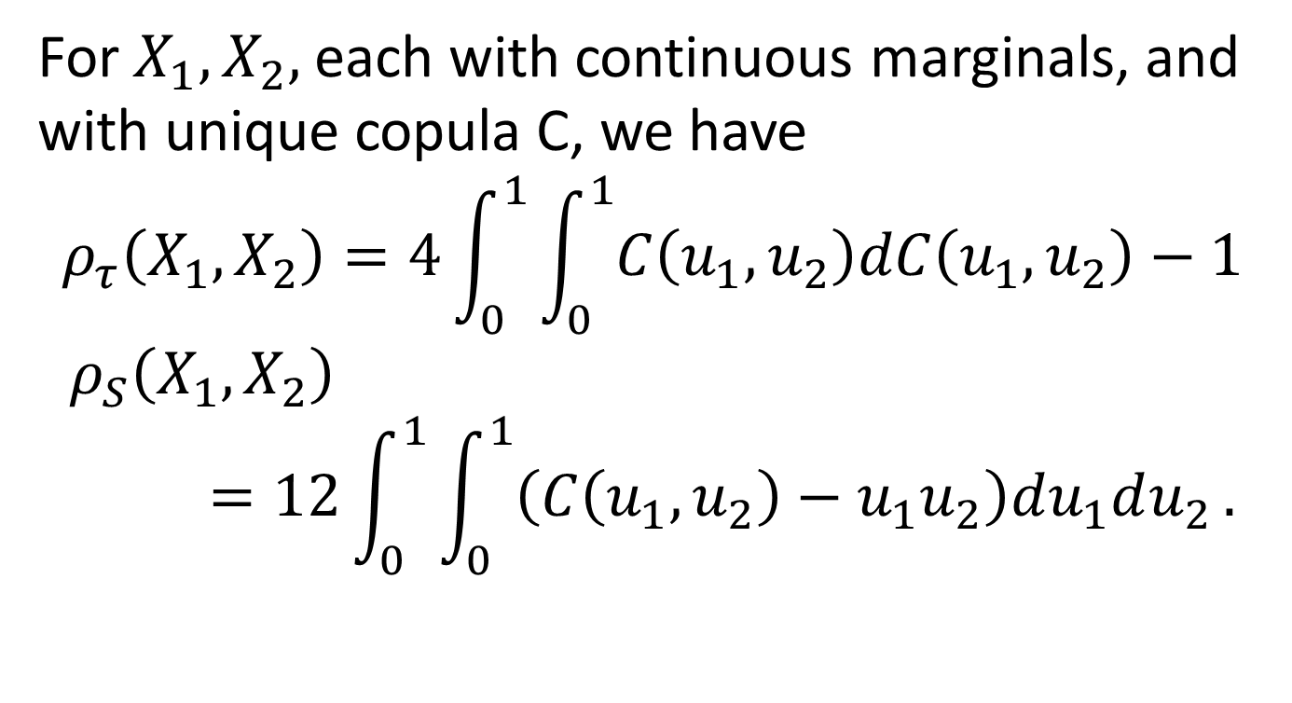
Calculating Rank Correlation
For $X_{1},X_{2},$each with continuous marginals, and with unique copula C, we have
$$ρ_{τ}\left(X_{1},X_{2}\right)=4\int_{0}^{1}{\int_{0}^{1}{C\left(u_{1},u_{2}\right)dC\left(u_{1},u_{2}\right)}}−1$$
$$ρ_{S}\left(X_{1},X_{2}\right)=12\int_{0}^{1}{\int_{0}^{1}{\left(C\left(u_{1},u_{2}\right)−u_{1}u_{2}\right)du_{1}du_{2}}}.$$

Slide 48
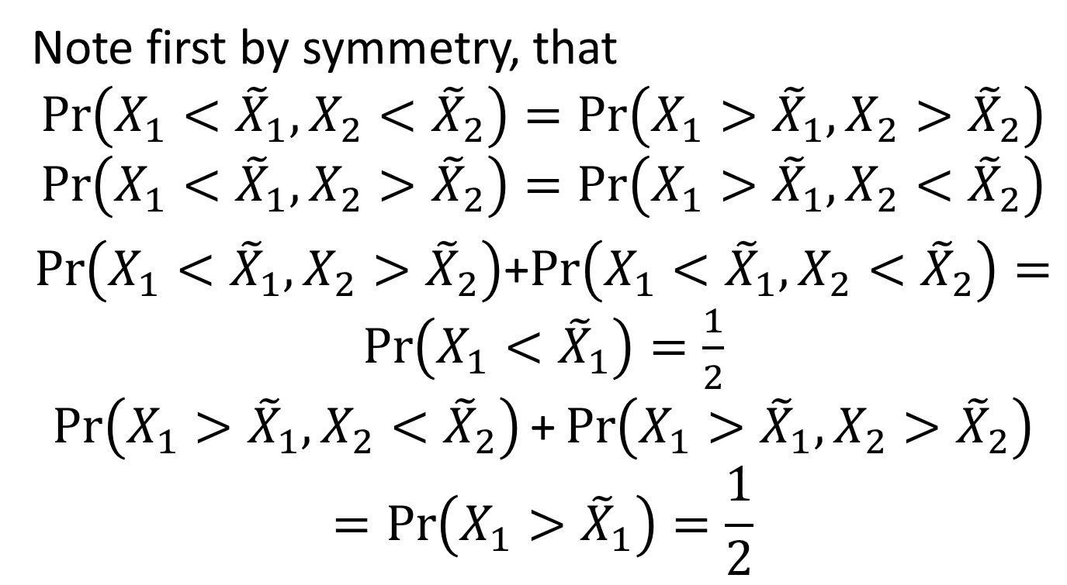
Calculating Rank Correlation, cont’d
Note first by symmetry, that
$$\operatorname{Pr}\left(X_{1}<{\tilde{X}}_{1},X_{2}<{\tilde{X}}_{2}\right)=\operatorname{Pr}\left(X_{1}>{\tilde{X}}_{1},X_{2}>{\tilde{X}}_{2}\right)$$
$$\operatorname{Pr}\left(X_{1}<{\tilde{X}}_{1},X_{2}>{\tilde{X}}_{2}\right)=\operatorname{Pr}\left(X_{1}>{\tilde{X}}_{1},X_{2}<{\tilde{X}}_{2}\right)$$
$\operatorname{Pr}\left(X_{1}<{\tilde{X}}_{1},X_{2}>{\tilde{X}}_{2}\right)$+$\operatorname{Pr}\left(X_{1}<{\tilde{X}}_{1},X_{2}<{\tilde{X}}_{2}\right)=\operatorname{Pr}\left(X_{1}<{\tilde{X}}_{1}\right)=\frac{1}{2}$
$$\operatorname{Pr}\left(X_{1}>{\tilde{X}}_{1},X_{2}<{\tilde{X}}_{2}\right)\text{+}\operatorname{Pr}\left(X_{1}>{\tilde{X}}_{1},X_{2}>{\tilde{X}}_{2}\right)=\operatorname{Pr}\left(X_{1}>{\tilde{X}}_{1}\right)=\frac{1}{2}$$

Slide 49
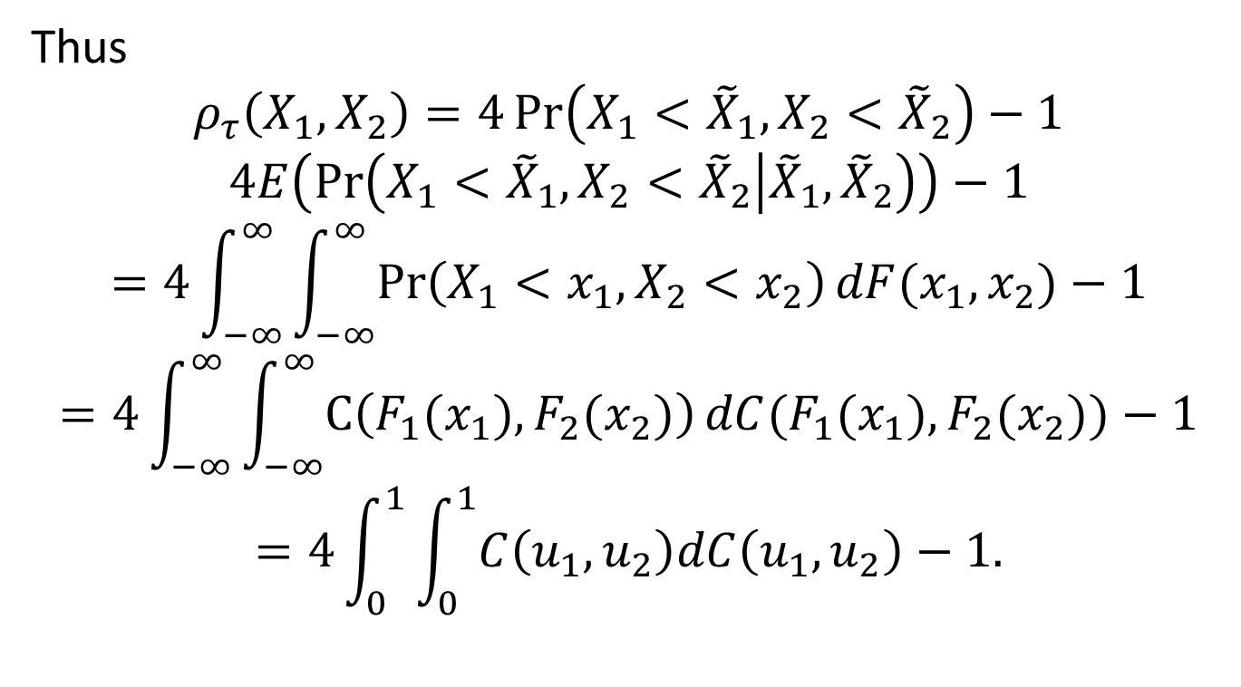
Calculating Rank Correlation, cont’d
Thus
$$ρ_{τ}\left(X_{1},X_{2}\right)=4\operatorname{Pr}\left(X_{1}<{\tilde{X}}_{1},X_{2}<{\tilde{X}}_{2}\right)−1$$
$$4E\left(\operatorname{Pr}\left(X_{1}<{\tilde{X}}_{1},X_{2}<{\tilde{X}}_{2} | {\tilde{X}}_{1},{\tilde{X}}_{2}\right)\right)−1$$
$$=4\int_{−∞}^{∞}{\int_{−∞}^{∞}{\operatorname{Pr}\left(X_{1}<x_{1},X_{2}<x_{2}\right)dF(x_{1},x_{2})}}−1$$
$$=4\int_{−∞}^{∞}{\int_{−∞}^{∞}{C\left(F_{1}(x_{1}), F_{2}(x_{2})\right)dC(F_{1}(x_{1}), F_{2}(x_{2}))}}−1$$
$$=4\int_{0}^{1}{\int_{0}^{1}{C\left(u_{1},u_{2}\right)dC\left(u_{1},u_{2}\right)}}−1.$$

Slide 50
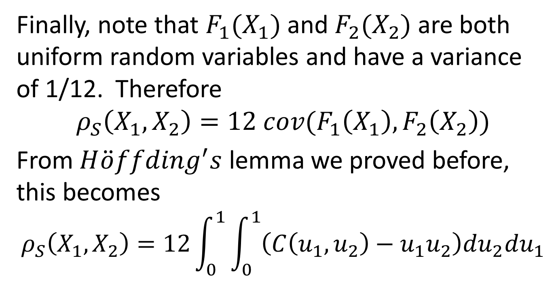
Calculating Rank Correlation, cont’d
Finally, note that $F_{1}(X_{1})$ and $F_{2}(X_{2})$ are both uniform random variables and have a variance of 1/12. Therefore
$$ρ_{S}\left(X_{1},X_{2}\right)=12 cov(F_{1}\left(X_{1}\right),F_{2}\left(X_{2}\right))$$
From $H\ddot{o}ffding^{′}s$ lemma we proved before, this becomes
$$ρ_{S}\left(X_{1},X_{2}\right)=12\int_{0}^{1}{\int_{0}^{1}{\left(C\left(u_{1},u_{2}\right)−u_{1}u_{2}\right)du_{2}du_{1}}}$$

Slide 51
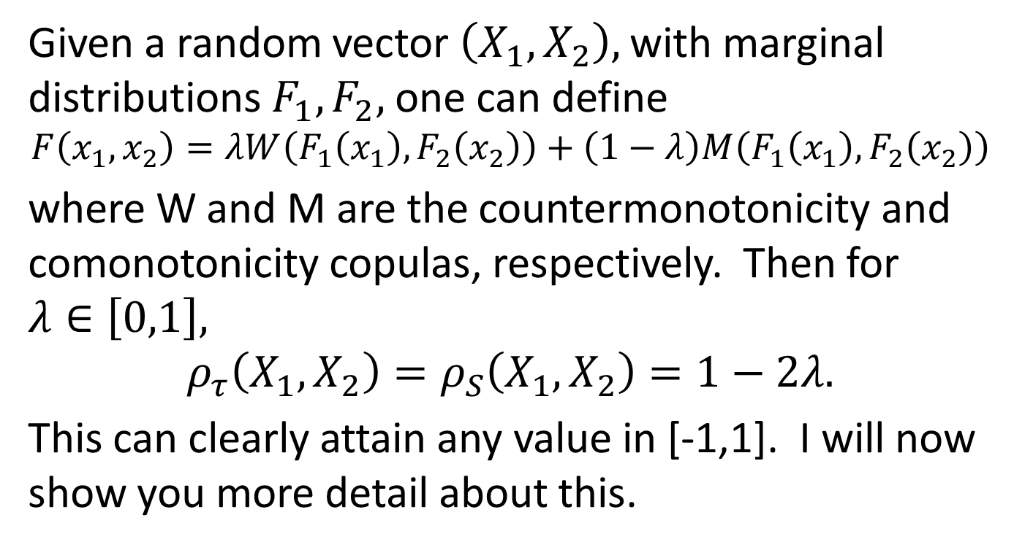
Rank Correlations are Attainable
Given a random vector $\left(X_{1},X_{2}\right),$ with marginal distributions $F_{1}, F_{2},$ one can define
$$F\left(x_{1},x_{2}\right)=λW\left(F_{1}\left(x_{1}\right),F_{2}\left(x_{2}\right)\right)+\left(1−λ\right)M\left(F_{1}\left(x_{1}\right),F_{2}\left(x_{2}\right)\right)$$
where W and M are the countermonotonicity and comonotonicity copulas, respectively. Then for $λ∈\left[0,1\right],$
$$ρ_{τ}\left(X_{1},X_{2}\right)=ρ_{S}\left(X_{1},X_{2}\right)=1−2λ.$$
This can clearly attain any value in [-1,1]. I will now show you more detail about this.

Slide 52
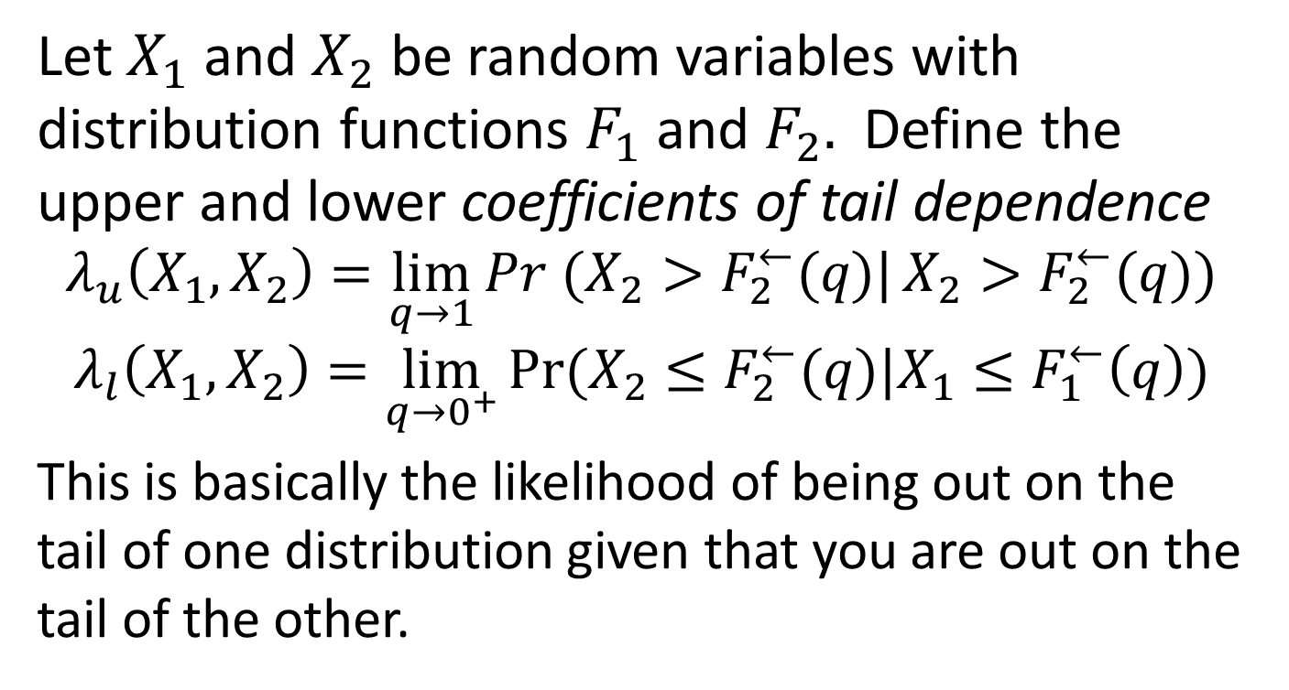
Tail Dependence
Let $X_{1}$ and $X_{2}$ be random variables with distribution functions $F_{1}$ and $F_{2}.$ Define the upper and lower coefficients of tail dependence
$$λ_{u}\left(X_{1},X_{2}\right)=\lim_{q→1}{Pr (X_{2}>F_{2}^{←}(q)|}X_{2}>F_{2}^{←}(q))$$
$$λ_{l}\left(X_{1},X_{2}\right)=\lim_{q→0^{+}}{Pr⁡(X_{2}≤F_{2}^{←}(q)|X_{1}≤F_{1}^{←}\left(q\right))}$$
This is basically the likelihood of being out on the tail of one distribution given that you are out on the tail of the other.

Slide 53

Tail Dependence is Symmetric
Suppose that $F_{1}$ and $F_{2}$ are continuous. Recall from the proof of Sklar’s theorem that
$$C\left(u_{1},u_{2}\right)=F(F_{1}^{←}\left(u_{1}\right),F_{2}^{←}\left(u_{2}\right))$$
$$∴λ_{l}=\lim_{q→0^{+}}{\frac{\operatorname{Pr}\left(X_{2}≤F_{2}^{←}\left(q\right),X_{1}≤F_{1}^{←}\left(q\right)\right)}{\operatorname{Pr}\left(X_{1}≤F_{1}^{←}\left(q\right)\right)}}$$
$$=\lim_{q→0^{+}}{\frac{C\left(q,q\right)}{q}}$$
Also
$$λ_{u}=\lim_{q→1^{−}}{\frac{\operatorname{Pr}\left(X_{2}>F_{2}^{←}\left(q\right),X_{1}>F_{1}^{←}\left(q\right)\right)}{\operatorname{Pr}\left(X_{1}>F_{1}^{←}\left(q\right)\right)}}$$
$$=\lim_{q→1}{\frac{\hat{C}\left(1−q,1−q\right)}{1−q}}=\lim_{q→0^{+}}{\frac{\hat{C}\left(q,q\right)}{q}}.$$

Slide 54

Normals Have No Tail Dependence
Suppose that $X_{1}∼N\left(0,1\right), X_{2}∼N\left(0,1\right), ρ=Corr\left(X_{1},X_{2}\right),$ and let C be the copula. Since this distribution is radially symmetric about the origin, C is radially symmetric about (0.5,0.5) and thus
$λ_{l}=λ_{u}=\lim_{q→0^{+}}{\frac{C\left(q,q\right)}{q}}=\lim_{q→0^{+}}{Pr⁡(U_{2}≤q|U_{1}=q)}+\lim_{q→0^{+}}{Pr⁡(U_{1}≤q|U_{2}=q)}=2\lim_{q→0^{+}}{Pr⁡(U_{2}≤q|U_{1}=q)}$.

Slide 55

Independent Normal Tails, cont’d
$$=2\lim_{q→0^{+}}{Pr⁡(N^{−1}\left(U_{2}\right)≤N^{−1}(q)|N^{−1}\left(U_{1}\right)=N^{−1}(q)}$$
$$=2\lim_{x→−∞}{Pr⁡(X_{2}≤x|X_{1}≤x)}$$
Now we write out the bivariate density, univariate density and finally the conditional density as
$$φ_{2}\left(x_{1},x_{2}\right)=\frac{1}{2π\sqrt{1−ρ^{2}}}\exp\left(−\frac{x_{1}^{2}−2ρx_{1}x_{2}+x_{2}^{2}}{2\left(1−ρ^{2}\right)}\right)$$
$$φ\left(x_{2}\right)=\frac{1}{\sqrt{2π}}e^{−\frac{1}{2}x^{2}}$$
$$ψ\left(x_{1} | x_{2}\right)=\frac{φ_{2}\left(x_{1},x_{2}\right)}{φ\left(x_{2}\right)}=\frac{1}{\sqrt{2π\left(1−ρ^{2}\right)}}\exp\left(−\frac{1}{2}\frac{{\left(x_{1}−ρx_{2}\right)}^{2}}{1−ρ^{2}}\right)$$
That is
$$X_{1}|(X_{2}=x)∼N(ρx,1−ρ^{2})$$

Slide 56

Independent Normal Tails, cont’d
Therefore
$$X_{1}<x|X_{2}=x⇔z\sqrt{1−ρ^{2}}+ρx≤x, z∼N\left(0,1\right), so$$
$$\operatorname{Pr}\left(X_{1}<x | X_{2}=x\right)=N\left(x\frac{1−ρ}{\sqrt{1−ρ^{2}}}\right)→0 as x→−∞.$$

Slide 57

But t-distribution Tails are NOT Independent
Now suppose $(X_{1},X_{2})$ have a bivariate t distribution with $ν$degrees of freedom and with variances 1 and correlation $ρ.$ Let $C_{ν,ρ}^{t}$ be the copula of this distribution; note that
$$F\left(X_{1},X_{2}\right)=C_{ν,ρ}^{t}\left(t_{ν}\left(X_{1}\right),t_{ν}\left(X_{2}\right)\right).$$
To compute the density of $X_{2}|\left(X_{1}=x\right),$ note that the 2-dim and 1-dim densities are
$$f\left(x,x_{2}\right)=\frac{Γ\left(\frac{1}{2}\left(ν+2\right)\right)}{Γ\left(\frac{ν}{2}\right)πν\sqrt{1−ρ^{2}}}{\left[1+\frac{x^{2}−2ρxx_{2}+x_{2}^{2}}{ν\left(1−ρ^{2}\right)}\right]}^{−\frac{ν}{2}−1}$$
$$f_{1}\left(x\right)=\frac{Γ\left(\frac{1}{2}\left(ν+1\right)\right)}{Γ\left(\frac{ν}{2}\right)\sqrt{πν}}{\left[1+\frac{x^{2}}{ν}\right]}^{−\frac{ν}{2}−\frac{1}{2}}$$

Slide 58

t-distribution Tail Dependence, cont’d
So the density of $X_{2}=x_{2}|X_{1}=x$ is the quotient, implying, after some arithmetic
$$\operatorname{Pr}\left(X_{2}≤x_{2} | X_{1}=x\right)=\int_{−∞}^{x_{2}}{\frac{Γ\left(\frac{1}{2}\left(ν+2\right)\right)}{Γ\left(\frac{1}{2}\left(ν+1\right)\right)\sqrt{π(ν+x^{2})\left(1−ρ^{2}\right)}}}{\left[1+\frac{{\left(y−ρx\right)}^{2}}{\left(ν+x^{2}\right)\left(1−ρ^{2}\right)}\right]}^{−\frac{ν}{2}−1}dy$$
This turns out to be the same as
$$t_{ν+1}\left(\frac{\left(x_{2}−ρx\right)\sqrt{ν+1}}{\sqrt{\left(ν+x^{2}\right)\left(1−ρ^{2}\right)}}\right).$$
Letting $x_{2}=x$ and letting $x→−∞,$ we get
$$λ_{l}=λ_{u}=2t_{ν+1}\left(−\sqrt{\frac{\left(ν+1\right)\left(1−ρ\right)}{1+ρ}}\right).$$

Slide 59

Some examples
The following table gives $λ$ for different degrees of freedom and different correlations:
t copulas can have some tail dependence even for negative correlations.
 | rho = -0.5 | rho = 0 | rho = 0.5 | rho = 0.9 | rho = 1
nu = 2 | 0.06 | 0.18 | 0.39 | 0.72 | 1.00
nu = 4 | 0.01 | 0.08 | 0.25 | 0.63 | 1.00
nu = 10 | 0.00 | 0.01 | 0.08 | 0.46 | 1.00
nu = infinity | 0.00 | 0.00 | 0.00 | 0.00 | 1.00
(Gaussian)

Slide 60

More on Rank Correlations
First a preliminary result on elliptical distributions:
Let $X∼E_{2}(0,Σ,ψ)$, and let $ρ=corr\left(X_{1},X_{2}\right),$ and also assume that $\operatorname{Pr}\left(X=0\right)=0.$ Then
$$\operatorname{Pr}\left(X_{1}>0,X_{2}>0\right)=\frac{1}{4}+\frac{\arcsin{ρ}}{2π}$$
Proof: First of all, without loss of generality we can assume that $Σ$ is just the correlation matrix, that is
$$Σ=\left(\begin{matrix}1 & ρ \\ ρ & 1\end{matrix}\right),$$
by dividing $X_{1}$ and $X_{2}$ by their standard deviations.

Slide 61

More on Rank Correlations, cont’d
From the decomposition theorem for elliptical distributions, $X$must have the same distribution as a linearly mapped spherical distribution $Z∼S_{2}\left(ψ\right),$that is,
$$cdf\left(X\right)=cdf(AZ)$$
$$A=\left(\begin{matrix}1 & 0 \\ ρ & \sqrt{1−ρ^{2}}\end{matrix}\right).$$
Note that $AA^{T}=Σ.$ $Z$ can be further broken down into a product of a radial r.v. and a uniform r.v. on the unit circle:

Slide 62

More on Rank Correlations, cont’d
$${cdf(X}_{1},X_{2})=cdf\left(R\left(\cos{Θ,ρ\cos{Θ+\sqrt{1−ρ^{2}}\sin{Θ}}}\right)\right).$$
$Θ$ is uniform on $\left[−π,π\right).$ Setting $φ=\arcsin{ρ}$and observing that $\operatorname{Pr}\left(R=0\right)=0,$ we get
$$\operatorname{Pr}\left(X_{1}>0,X_{2}>0\right)=Pr⁡(\cos{Θ>0,\sin{φ\cos{Θ+}}\sin{Θ\cos{φ}}>0) }$$
$$=Pr⁡(\cos{Θ>0,\sin\left(φ+Θ\right)>0)}$$
$$=\operatorname{Pr}\left(Θ∈\left(−\frac{π}{2},\frac{π}{2}\right),Θ+φ∈\left(0,π\right)\right)$$
$$=Pr⁡(Θ∈\left(−φ,\frac{π}{2}\right)$$
$$=\frac{π/2+φ}{2π}$$
$$=\frac{1}{4}+\frac{\arcsin\left(ρ\right)}{2φ}$$

Slide 63

Rank Correlations for Gaussian Copulas
Now suppose that $X$ is a bivariate distribution with continuous margins and with the 2 dimensional Gaussian copula coming from the 2-D normal distribution with correlation $ρ.$ Then Kendall’s tau
$$ρ_{τ}\left(X_{1},X_{2}\right)=\frac{2}{π}\arcsin{ρ}.$$
To see this, note that we can just assume that $X$is just bivariate standard normal with correlation $ρ$, since rank correlation only depends on the copula.

Slide 64

Gaussian Copulas, cont’d
By symmetry, it is easy to show that
$$ρ_{τ}\left(X_{1},X_{2}\right)=4\operatorname{Pr}\left(X_{1}−{\tilde{X}}_{1}>0,X_{2}−{\tilde{X}}_{2}>0\right)−1,$$
where ${\tilde{X}}_{1},{\tilde{X}}_{2}$ are independent copies of $X_{1},X_{2}.$ But the vector $Y=X−\tilde{X}∼N\left(0,Σ\right),$ with
$$Σ=\left(\begin{matrix}2 & 2ρ \\ 2ρ & 2\end{matrix}\right).$$
From the previous result,
$$ρ_{τ}\left(X_{1},X_{2}\right)=4\left(\frac{1}{4}+\frac{\arcsin{ρ}}{2π}\right)−1=\frac{2}{π}\arcsin{ρ}$$

Slide 65

Gaussian Copulas, cont’d
For Spearman’s rho, the claim is that
$$ρ_{S}\left(X_{1},X_{2}\right)=\frac{6}{π}\arcsin\left(\frac{ρ}{2}\right).$$
To see this,
$ρ_{S}\left(X_{1},X_{2}\right)=12\int_{0}^{1}{\int_{0}^{1}{\left(C\left(u_{1},u_{2}\right)−u_{1}u_{2}\right)du_{1}du_{2}}}$
$$=12\int_{0}^{1}{\int_{0}^{1}{\operatorname{Pr}\left(N\left(X_{1}\right)<u_{1},N\left(X_{2}\right)<u_{2}\right)du_{1}du_{2}}}−3$$
$$=12\int_{0}^{1}{\int_{0}^{1}{\operatorname{Pr}\left(X_{1}<N^{−1}(u_{1}),N\left(X_{2}\right)<N^{−1}(u_{2})\right)du_{1}du_{2}}}−3$$
$$=12\int_{−∞}^{∞}{\int_{−∞}^{∞}{\operatorname{Pr}\left(X_{1}<x_{1},X_{2}<x_{2}\right)φ\left(x_{1}\right)φ\left(x_{2}\right)dx_{1}dx_{2}}}−3$$
$$=12E\left(\operatorname{Pr}\left(X_{1}<Z_{1},X_{2}<Z_{2} | Z_{1},Z_{2}\right)\right)−3, Z∼N\left(0,I_{2}\right)$$
$Z$ independent of $X$.

Slide 66

Gaussian Copulas, cont’d
Thus
$$ρ_{S}\left(X_{1},X_{2}\right)=12\operatorname{Pr}\left(Z_{1}−X_{1}>0,Z_{2}−X_{2}>0\right)−3$$
But
$$Z−X=Y∼N(0,Σ)$$
$$Σ=\left(\begin{matrix}2 & ρ \\ ρ & 2\end{matrix}\right)=2\left(\begin{matrix}1 & ρ/2 \\ ρ/2 & 1\end{matrix}\right).$$
Using the same argument as for Kendall’s tau,
$$ρ_{S}\left(X_{1},X_{2}\right)=3 ×\frac{2}{π}\arcsin\left(\frac{ρ}{2}\right).$$

Slide 67

Kendall’s tau result generalizes
If $X∼E_{2}\left(0,Σ,ψ\right),$with
$$Σ=\left(\begin{matrix}1 & ρ \\ ρ & 1\end{matrix}\right)$$
and $\operatorname{Pr}\left(X=0\right)=0$, then we still have
$ρ_{τ}\left(X_{1},X_{2}\right)=\frac{2}{π}\arcsin{ρ}$.
The reason is that $X−\tilde{X}$ is still elliptical, perhaps with a different generator, and the result for $Pr⁡(X_{1}−{\tilde{X}}_{1}>0,X_{2}−{\tilde{X}}_{2}>0)$ that we showed earlier still holds.
However the Spearman’s rho result does not generalize.

Slide 68

Grouped t Copulas
The idea is to slap a bunch of copulas from normal mixtures, each coming from a different t distribution, together into one copula.
Here is the algorithm:
Generate independently $Z∼N_{d}\left(0,Σ\right),$ with $Σ$ being a correlation matrix, and a uniform random variable $U.$
Divide the set $\{1,…,d\}$ up into m subsets of sizes $s_{1},…,s_{m}$ and for all $k$ such that $1≤k≤m,$ let $ν_{k}$ be the degrees of freedom parameter for a t distribution.

Slide 69

Grouped t copula algorithm, cont’d
Set $W_{k}=G_{ν_{k}}^{−1}\left(U\right),$ where $G_{ν}$ is the distribution function of the univariate $Ig(\frac{ν}{2},\frac{ν}{2})$ (inverse Gamma) distribution, so that $W_{1},…,W_{m}$ are comonotonic and inverse-Gamma distributed random variables, with different degrees of freedom.
Now let
$$X={\left(\sqrt{W_{1}}Z_{1},…,\sqrt{W_{1}}Z_{s_{1}},\sqrt{W_{2}}Z_{s_{1}+1},…,\sqrt{W_{2}}Z_{s_{1}+s_{2}},…,\sqrt{W_{m}}Z_{d}\right)}^{T}$$
$$U={\left(t_{ν_{1}}\left(X_{1}\right),…,t_{ν_{1}}\left(X_{s_{1}}\right),t_{ν_{2}}\left(X_{s_{1}+1}\right),…,t_{ν_{2}}\left(X_{s_{1}+s_{2}}\right),…,t_{ν_{m}}\left(X_{d}\right)\right)}^{T}$$
Then $X$ has a grouped t distribution and $U$ is a grouped t copula.
This may be appropriate for a book that contains a bunch of spot risk factors, a bunch of volatility risk factors, interest rates, etc.

